Slide 1
MINNESOTA TECHNOLOGY ASSOCIATION
2022 ACE LEADERSHIP
GROUP PRESENTATIONS

Slide 2
MINNESOTA TECHNOLOGY ASSOCIATION
Challenge: Minnesota is facing a technology talent crisis, and an ecosystem wide approach will be required to respond. The board of MnTech and the MnTech Foundation are requesting the catalytic investment of $1M in funds over the next two years to equitably rebuild Minnesota's technology talent pipeline.

Slide 3
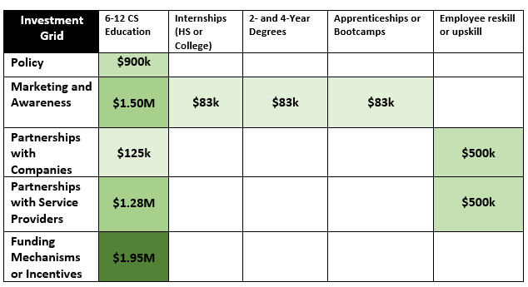

Slide 4
MINNESOTA TECHNOLOGY ASSOCIATION
2022 ACE LEADERSHIP
GROUP 2
Arun Purushothaman, Land O'Lakes
Scott Brons, SPS Commerce
Kathryn Wolfram, Target
Andy Lind, Surescripts

Slide 5
~13,000 open jobs in computing/month in MN and expected to increase
~1,500 graduated in CS in MN
24% of public schools teach a CS class in MN
3 CS teachers graduated MN prep programs in 2018
LEADING INDICATORS

Slide 6
Hook, line, and hire!

Slide 7
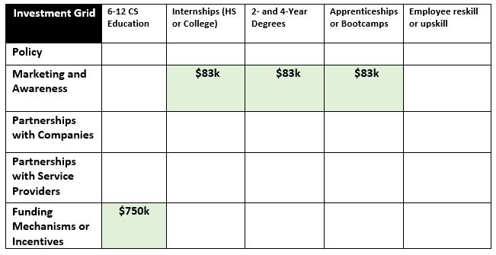
INVESTMENT APPROACH

Slide 8
$750k (75%) - Public middle & high school
Increase the availability of middle and high school Computer Science education in MN
Pilot grants for computer science educators and counselors in BIPOC & predominately diverse schools
KEY INVESTMENT THEMES
$250k (25%) - Marketing
Support students with program and community efforts that hand-hold beyond graduating high school and help funnel towards open jobs
Promote additional computer science programs, bootcamps, apprenticeships, or other post-secondary training

Slide 9
Public middle & high school
Adoption Metric: # of middle/high school students participating in class offerings and diversity rates
Teacher Metric: # CS teachers graduated MN prep programs.
KEY Measures
Of Success
Marketing
Community Engagement: # Survey of students tracking interest in continuation of tech post high-school graduation
Notes:
During presentation – hit on the why these numbers as top metrics (may be difficult to get, will need to partner with community engagement, but could down the line shape policy changes and track success of recommend pilots)

Slide 10
QUESTIONS?
Notes:
Policy –
Get the “CS for All” policy passed. (Support for csforall.org)
Giving schools the money to implement any statewide policies that may be passed.
Marketing & Awareness
Marketing to schools to bring awareness around development options for existing teachers – awareness to existing programs
Awareness to schools about stipend for meeting student threshold
Partnerships w/ Service Providers
Not reinventing the wheel
Utilize existing programs to train current teachers & cover the cost of these programs (e.g. TEALS)
Funding Mechanisms & Incentives
Stipend for schools that get at least 10 students in their CS class (to ensure proper equipment/resources are available).

Slide 11
MINNESOTA TECHNOLOGY ASSOCIATION
2022 ACE LEADERSHIP
GROUP 1
Anna Maxam, Target; Tyrel Dawson, Comcast; Sheanne Anderson, Comcast; Jen Bentrim, University of Minnesota
Notes:
Policy –
Get the “CS for All” policy passed. (Support for csforall.org)
Giving schools the money to implement any statewide policies that may be passed.
Marketing & Awareness
Marketing to schools to bring awareness around development options for existing teachers – awareness to existing programs
Awareness to schools about stipend for meeting student threshold
Partnerships w/ Service Providers
Not reinventing the wheel
Utilize existing programs to train current teachers & cover the cost of these programs (e.g. TEALS)
Funding Mechanisms & Incentives
Stipend for schools that get at least 10 students in their CS class (to ensure proper equipment/resources are available).

Slide 12
Technology positions needing to be filled are out-pacing technologists available to fill them.
Foundational computer science education in high school is severely lacking.
Shortage of High school teachers qualified to teach CS.
LEADING INDICATORS

Slide 13
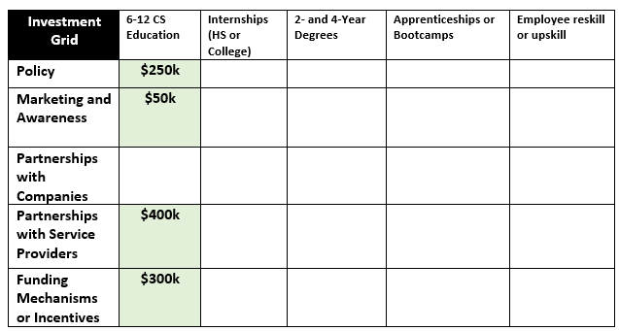
INVESTMENT APPROACH

Slide 14
Public Policy
FOLLOW CSFORALLMN'S LEAD
KEY INVESTMENT THEMES
Marketing & Awareness
INFORM SCHOOLS & TEACHERS OF PROGRAMS
Service Provider PARTNERNSHIPS
HARNESS EXISTING PROGRAMS
FUNDING MECHANISMS & INCENTIVES
STIPENDS FOR SCHOOLS & FUND TEACHER TRAINING
Notes:
Based on what we've seen from other states one of the best ways to improve statewide computer science education is to have policies that require high schools to provide CS classes. There is alreeady a collaborative in MN that exists that's working on this initiative called CS for All MN (?) so we believe putting some funds towards supporting that collaborative will be one of the most effective ways to (forward the policy side of this issue)?
September 16, 2022 at 3:13 PM

Slide 15
Increase CS Courses
DOUBLE NUMBER OF CLASSES TAUGHT
KEY INVESTMENT THEMES
Prepare Training Teachers
CLEAR CERTIFICATION PATHWAY
Upskill Current Teachers
TRAIN EXISTING TEACHERS (E.G. TEALS)

Slide 16
QUESTIONS?
Notes:
Policy –
Get the “CS for All” policy passed. (Support for csforall.org)
Giving schools the money to implement any statewide policies that may be passed.
Marketing & Awareness
Marketing to schools to bring awareness around development options for existing teachers – awareness to existing programs
Awareness to schools about stipend for meeting student threshold
Partnerships w/ Service Providers
Not reinventing the wheel
Utilize existing programs to train current teachers & cover the cost of these programs (e.g. TEALS)
Funding Mechanisms & Incentives
Stipend for schools that get at least 10 students in their CS class (to ensure proper equipment/resources are available).

Slide 17
MINNESOTA TECHNOLOGY ASSOCIATION
2022 ACE LEADERSHIP
GROUP 3
Kendra Apelt, AVI Systems
Marcel Holste, Carl Zeiss Industrial Metrology,LLC
Cristina Lalley, Thomson Reuters
Dao Lee, Land O' Lakes
Aim Notthakun, Winnebago Industries

Slide 18
Vacancy rate > 5% for technologists in Minnesota
Minnesota High Schools rank last in national comparison of high schools offering computer science (CS) classes
CS Advanced Placement exam participation rate among minorities are [14x] lower compared to white students
LEADING INDICATORS

Slide 19
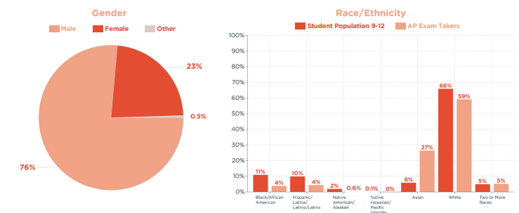
LEADING INDICATORS

Slide 20
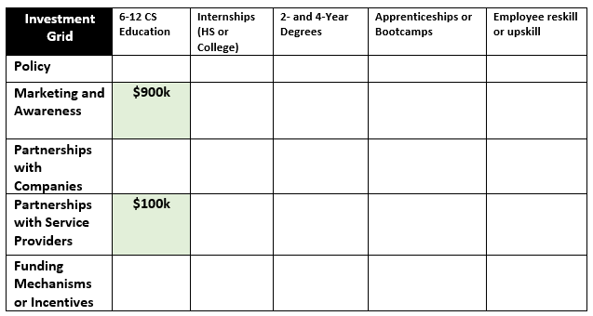
INVESTMENT APPROACH

Slide 21
INVESTMENT A
Marketing and Awareness
Increase the awareness and attractiveness of technology careers to high school students, especially to groups of minorities. Includes a social media marketing campaign aimed at attractiveness (job market, pay, pathways) and removing the perceived barriers to learning technology and pursuing a technology career.
KEY INVESTMENT THEMES
INVESTMENT B
Partnerships with Service Providers
There is a saturated market of pathways to technology learning and employment partnerships, available in Minnesota, that are seeking interested candidates. A need is present to help connect the candidates to the pathways and opportunities already available.

Slide 22
Increase visibility and attractiveness to teens about technology careers.
Bring awareness to existing provider programs via marketing campaigns – meet the teens where they are – social media campaigns and schools.
Establish and maintain a website to consolidate the existing pathways, programs, and opportunities that are available in a cohesive site.
The site would guide teens on how to engage with the Service Providers as they are looking to pursue technology learning and careers.
Work with the Service Providers on how to be less intimidating to potential applicants.
INVESTMENT OBJECTIVES

Slide 23
QUESTIONS?
Notes:
Policy –
Get the “CS for All” policy passed. (Support for csforall.org)
Giving schools the money to implement any statewide policies that may be passed.
Marketing & Awareness
Marketing to schools to bring awareness around development options for existing teachers – awareness to existing programs
Awareness to schools about stipend for meeting student threshold
Partnerships w/ Service Providers
Not reinventing the wheel
Utilize existing programs to train current teachers & cover the cost of these programs (e.g. TEALS)
Funding Mechanisms & Incentives
Stipend for schools that get at least 10 students in their CS class (to ensure proper equipment/resources are available).

Slide 24
MINNESOTA TECHNOLOGY ASSOCIATION
2022 ACE LEADERSHIP
GROUP 4
David King, Digineer
Jerel Thompson, SPS Commerce
Thomas Kwong, University of Minnesota
Ginger Ovall, LandO'Lakes
Notes:
Introduction Slide – Who we are

Slide 25
2021 Minnesota is in last place at 24% for computer science classes offered to high school students in US. 2022 they remain in last place at 21%.
Minnesota does not offer dedicated funding for computer science professional development for teachers
Minnesota does not require that all secondary schools offer computer science classes
LEADING INDICATORS
Notes:
Problem Slide – State the problem
Widen the funnel

Slide 26
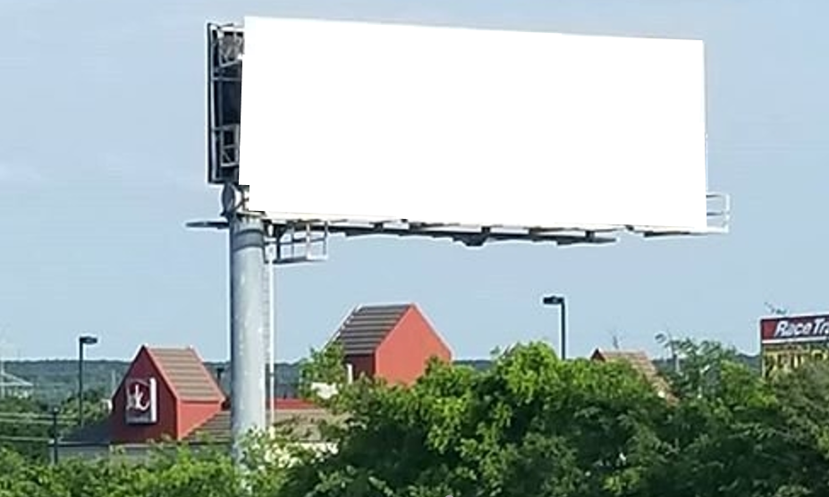
Technology is shaping our future
Too bad your child won’t be apart it!
Minnesota Public Schools ranked
50th out of 50 states in
computer science.
Notes:
Attention grabber – Bring Attention to the issue

Slide 27
INVESTMENT APPROACH
High School
College Degree
Internships
Post-Secondary Training
Notes:
How – How are we spending the money
Jerel – 4 & 5 Approach (funnel) and Key Themes

Slide 28
INVESTMENT APPROACH
High School
Target the largest audience
Seeds opportunities that could be realized later
College Degree
Internships
Post-Secondary Training
Notes:
How – How are we spending the money
Jerel – 4 & 5 Approach (funnel) and Key Themes

Slide 29
Reshape Public Policy
Lobby for dedicated funds for teacher CS professional development and CS class offering
KEY INVESTMENT THEMES
Marketing and Awareness
Drive constituent advocacy to improve CS education in Minnesota
Tech for Youth career fair
Meet high school students where they are at and open pathways to technology careers
Notes:
What – Describe what we are doing

Slide 30
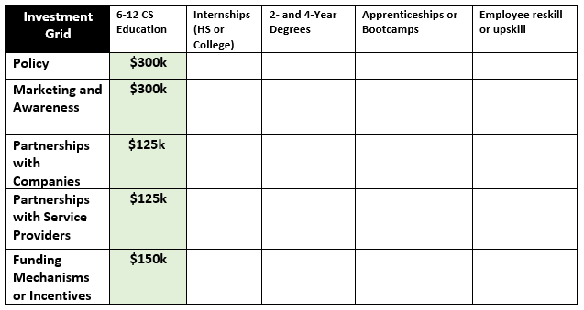
INVESTMENT APPROACH

Slide 31
Marketing Campaign
Create ad campaign targeted to bring broad awareness to lack of CS education in Minnesota
Next Steps
2. Public Policy
Develop a lobbying strategy
Identify key stakeholders to influence CS standards
3. Tech for Youth
Explore potential sponsors and participants
Engage with High Schools to gain buy in

Slide 32
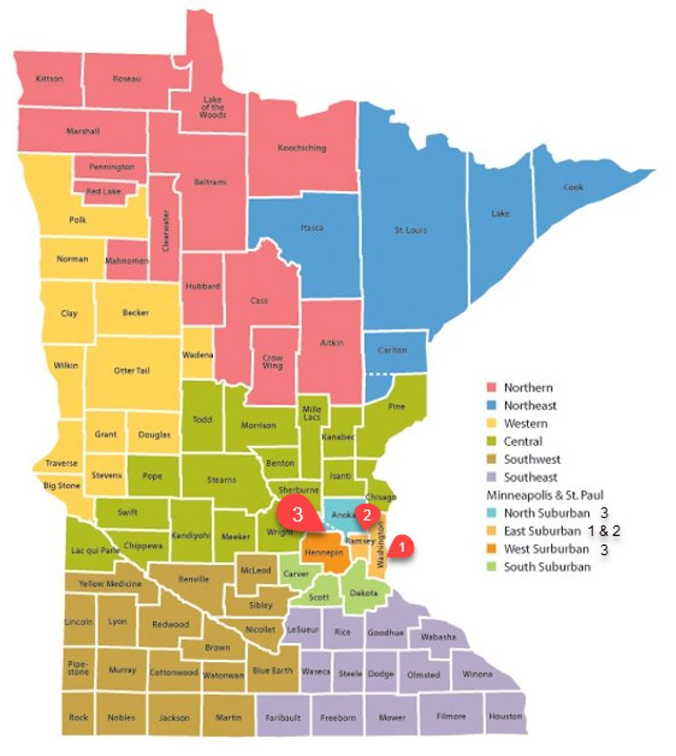
Regional Event
Accessible
Proof of Concept
Tech for Youth

Slide 33
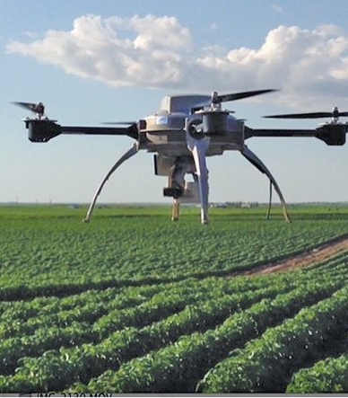
Technology in all industries
Beauty | Fashion | Farming
Gaming | Medicine | Sports
Notes:
Ginger “the Closer”

Slide 34
QUESTIONS?
Notes:
Policy –
Get the “CS for All” policy passed. (Support for csforall.org)
Giving schools the money to implement any statewide policies that may be passed.
Marketing & Awareness
Marketing to schools to bring awareness around development options for existing teachers – awareness to existing programs
Awareness to schools about stipend for meeting student threshold
Partnerships w/ Service Providers
Not reinventing the wheel
Utilize existing programs to train current teachers & cover the cost of these programs (e.g. TEALS)
Funding Mechanisms & Incentives
Stipend for schools that get at least 10 students in their CS class (to ensure proper equipment/resources are available).

Slide 35
MINNESOTA TECHNOLOGY ASSOCIATION
2022 ACE LEADERSHIP
GROUP 5
Abbi Butterfield, Digineer
Andrew Niederhauser, SEH
Irenius Eremon, Rimage
John Ahrens, CHS
Kristen Thurber, Donaldson

Slide 36
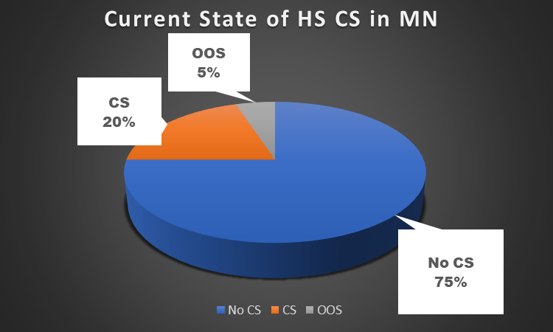
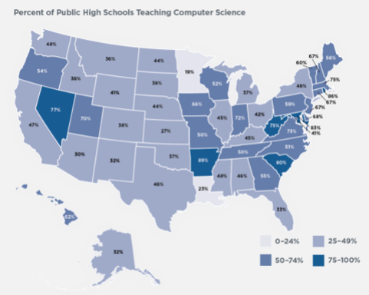
LEADING INDICATORS
Notes:
MN has 0 certified CS teachers and no certification program to develop them.

Slide 37
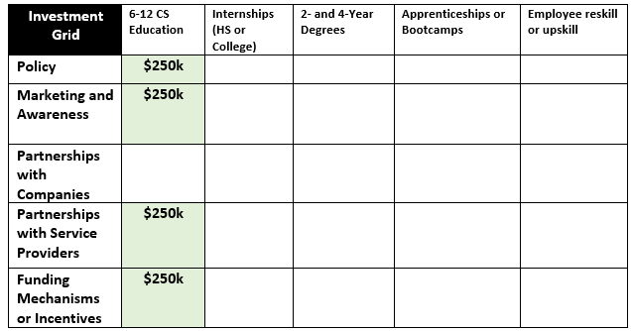
INVESTMENT APPROACH

Slide 38
INVESTMENT Public Policy Passage
KEY INVESTMENT THEMES
The MNTech Foundation should lobby for the passage of HF3243 and SF3578
INVESTMENT High School POC
Develop HS computer science curriculum
Create teacher training and accreditation
Promote curriculum and accreditation to 4-6 school districts as a PoC
Hire support staff for the PoCs.
Notes:
Long-term – state leads effort
Short-term – test out some proof-of-concepts to see what works for Minnesota
It may take awhile to get government support and implement these policies. Therefore, we can conduct a POC using lessons learned from other states with successful computer programs in their high schools. For example: Arkansas statistics….
At least on POC district should be non-metro

Slide 39
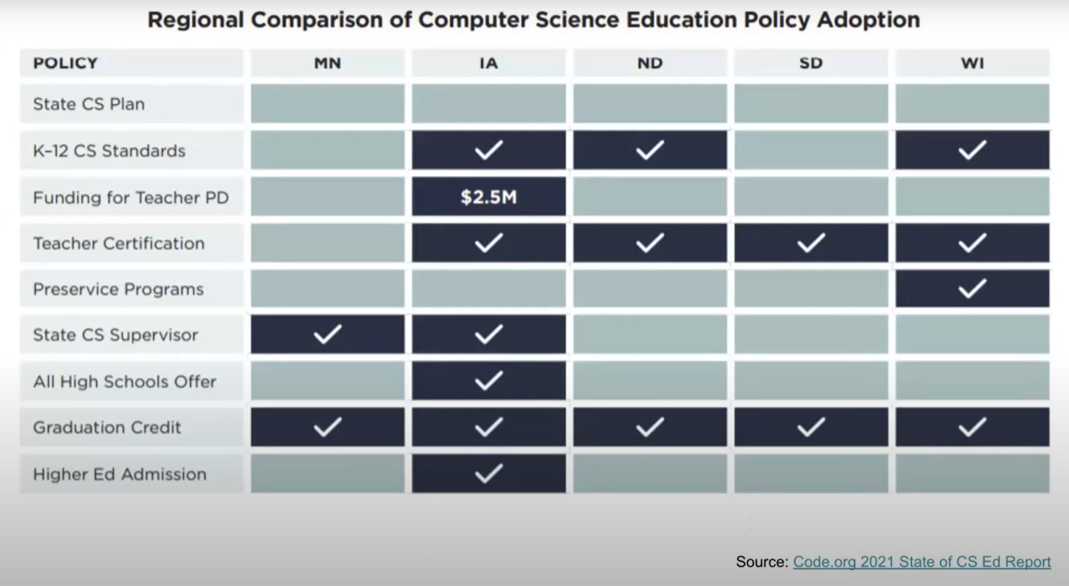
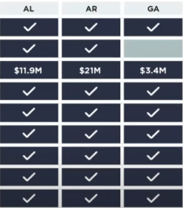
Policy Comparison
KEY INVESTMENT THEMES
Notes:
Programs exist and we can learn from them
Do a POC with 4-6 Schools

Slide 40
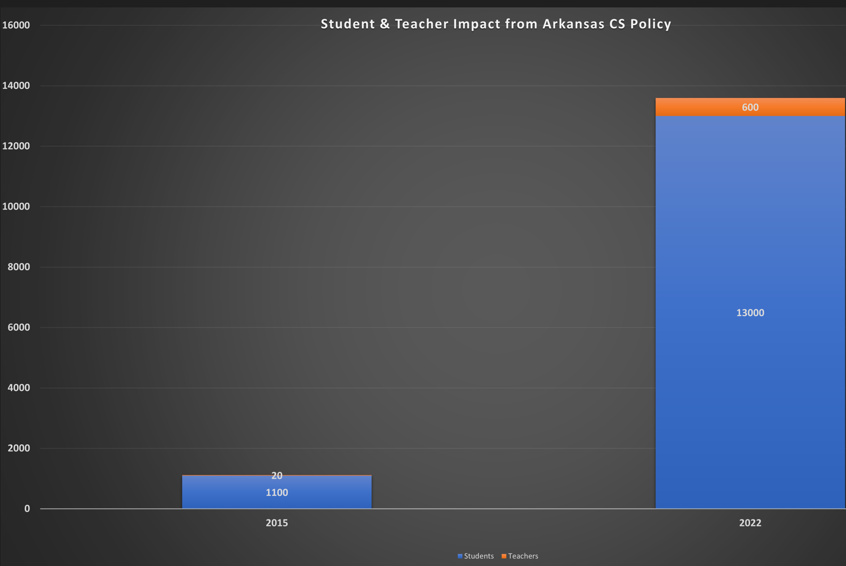
KEY INVESTMENT THEMES
Notes:
Arkansas raised the number of technologists to over 13,000 in 7 years. Using them as a role model, we should be able to make our goal of 10,000 technologists by 2030
Summary point – how we met original goal – 10,000 new technologists by 2030

Slide 41
QUESTIONS?
Notes:
Policy –
Get the “CS for All” policy passed. (Support for csforall.org)
Giving schools the money to implement any statewide policies that may be passed.
Marketing & Awareness
Marketing to schools to bring awareness around development options for existing teachers – awareness to existing programs
Awareness to schools about stipend for meeting student threshold
Partnerships w/ Service Providers
Not reinventing the wheel
Utilize existing programs to train current teachers & cover the cost of these programs (e.g. TEALS)
Funding Mechanisms & Incentives
Stipend for schools that get at least 10 students in their CS class (to ensure proper equipment/resources are available).

Slide 42
MINNESOTA TECHNOLOGY ASSOCIATION
2022 ACE LEADERSHIP
GROUP 7
Amanda Swan, SPS Commerce
Chad Boelter, Mayo Clinic
Dave Loveridge, Securian Financial
Lisa Oezalpay, Comcast
Ted Ellefson, Seagate

Slide 43
MN is dead last in percentage of high schools offering Computer Science
Strengths we can draw upon for closing the gap
Great students – ranked #6 in the US
High quality teachers
Organizations that support our education system
Lobbying for increasing focus on Computer Science in MN schools
LEADING INDICATORS
Notes:
Talking points:
You've already heard from 6 other teams about the gap MN is facing with increasing demand for IT talent that is outpacing the supply
Minnesotan's have a proud tradition with our educational system.
We were truly shocked to find that MN is still ranked 50th out of 50 states for Computer Science offerings in high schools! For all the investment and pride we take in our states education, how could we possibly be dead last in such a critical area?
Our proposal is to leverage some strengths of our education system to turn this around, and as a result, address the root challenge of increasing IT support in MN in the year ahead.
One thing we want to highlight is that we have some great pieces available to start addressing this problem.
We have great students – ranked #6 in the US.
We have high quality teachers, which help is get to high student rankings
We have organizations already exist today to support our educational system
And we have active lobbyists that are working to increase the focus on Complete Science in MN schools.

Slide 44
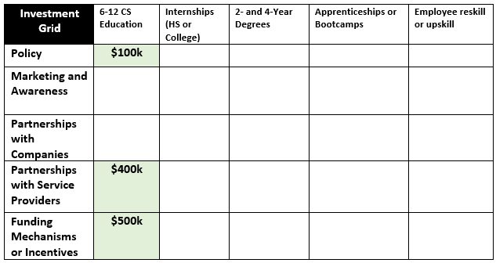
INVESTMENT APPROACH

Slide 45
POLICY
Fund lobbyist activity to change MN graduation requirements to include a computer science elective classes
KEY INVESTMENT THEMES
Southeast Service Coopertive
Fund cooperative partners for their support in finding/funding teachers training programs, student curriculum, and establishing pilot schools
Teacher Incentives
Incentivize teachers by creating CS certification pathways, financial incentives, and professional advancement opportunities.

Slide 46
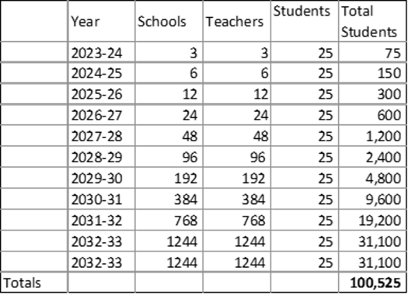
Supporting
Data

Slide 47
QUESTIONS?
Notes:
Policy –
Get the “CS for All” policy passed. (Support for csforall.org)
Giving schools the money to implement any statewide policies that may be passed.
Marketing & Awareness
Marketing to schools to bring awareness around development options for existing teachers – awareness to existing programs
Awareness to schools about stipend for meeting student threshold
Partnerships w/ Service Providers
Not reinventing the wheel
Utilize existing programs to train current teachers & cover the cost of these programs (e.g. TEALS)
Funding Mechanisms & Incentives
Stipend for schools that get at least 10 students in their CS class (to ensure proper equipment/resources are available).

Slide 48
MINNESOTA TECHNOLOGY ASSOCIATION
2022 ACE LEADERSHIP
Image of trees
GROUP 6
Ian King, CHS
James Luster, Comcast
Nicole Mewes, Best Buy
Kris Patrow, Padilla
Emily Paulson, Digineer
Notes:
We've all heard the saying, "You can't see the forest for the trees." Meaning, that a person or organization can't see the big picture because they're too focused on the details. Contrary to this idiom, we are choosing to focus on a detail. And by activating on this detail with intention, we can spend $1M over two years to address the acute phase of MN's talent crisis.

Slide 49
Upskill the employees you already have.
THE SOLUTION
Notes:
Our recommendation is to upskill the employees you already have.
Think about it.
Making a "catalytic" impact with $1M in a two-year time frame is a tall order, especially when we look at the ecosystem of causes for the talent crisis:
Lack of primary and secondary education in tech – MN ranked last
Policy issues/MN tax status being unfavorable to tech/startups
MN no longer being a leader in IT innovation, which negatively impacts recruitment
IT employees being hired away by corporations in other states, etc.
Even the snow can be a quality of life factor that has talented employees longing for a change
What really could make a measurable difference in the short-term as myriad other efforts are underway to address the longer-term solution? Our solution: Why not upskill the employees you already have? For example:
At 3M, we were implementing SAP across Plants/Distribution
on complex ecosystem of causes
Myriad efforts already underway to address policy, education, tax status, innovation, attrition contributors
Employers investing heavily in external recruitment incentives
Meanwhile, tens of thousands of their entry-level and/or hourly employees – many of whom are users or even super-users of their company's technology – are going untapped for these open positions

Slide 50
Upskilling is Becoming Business Critical
More than 60% of HR leaders say upskilling is their #1 priority
- Gartner
Nearly 70% of organizations are doing more skill building to prepare for the future - McKinsey
More than 50% of employees need to upskill/reskill by 2025 – World Economic Forum
LEADING INDICATORS
Notes:
From Gartner to McKinsey...these organizations have sounded the alarm that upskilling is business critical. The World Economic Forum went so far to report that over 50% of employees around the world need to upskill or reskill by 2025 to embrace the changing nature of jobs. They are putting move value on role the existing workforce can play to solve this problem vs the pipeline of in coming entry-level talent.
Two familiar companies are already putting this recommendation into action:

Slide 51
Free education and skills training for hourly employees to secure high-growth jobs within the company.
Upskilling in action
Plant and Distribution center employees were able to get IT experience. They had the opportunity to become Subject Matter Experts and even grow into full-time corporate IT roles.
Notes:
Amazon is investing $1.2 billion investment in upskilling its existing workforce underscores the value both Amazon and its employee places on professional development and career growth opportunities, which in turn improve retention and engagement.
3M is another great use case. Ian – what success has 3M seen?
At 3M, SAP was being implemented across Plants/Distribution Centers globally. To be successful, help would be elicited from workers at the plants/distribution centers where the technology was being rolled out. These workers would take teams through the warehouse, help build out useful test scenarios, then learn the system. By the time the software was implemented, these workers had become SAP experts with real life business knowledge. 3M would often tap these workers to move into IT roles within SAP. This allowed the company to advance the careers and skillsets of internal employees, while also reaping the benefits of that employees’ and it also benefited them to have someone who had the business and technological expertise to assist in future rollouts.
Thanks Nicole. I saw 3M have success in upskilling and reskilling their plant and distribution center employees.

Slide 52
Decreased costs
Fill jobs faster
Promote professional development
Strengthen employee retention
BENEFITS
Notes:
Less expensive: 6X less expensive to upskill/reskill than to hire external talent; no recruitment fees
Time: faster to upskill and deploy employees already familiar with company's operations; the jobs they leave behind are those easier to fill
Retention:
94% employees say they would stay at their current companies longer if employers invested in their careers
Employees already established in Minnesota are less likely to be "coasted" by out-of-state employers.
Recruitment: professional development/career growth opportunities attract more prospects

Slide 53
PHASE I - SCOUT
Hire a consultant to identify potential upskilling partners
KEY INVESTMENT THEMES
PHASE II – SHAPE
Develop an upskilling program and review it with the MNTech Board
PHASE III – SHIFT
Launch upskilling program
Notes:
MCKINSEY METHOD
PHASE I: SCOUT
Perform secondary research on upskilling/re-skilling trends, value and opportunities among Minnesota companies (to get buy-in and best practices)
Convene an employer advisory council to:
Align on needs, approaches, milestones, metrics
Share best practices (and meet quarterly)
Research and develop partnerships with proven tech upskilling partners/experts, to help advise on the development of this initiative across companies
PHASE II: SHAPE
MNTech works with tech upskilling providers, advisory council and beta employers to design pilot upskilling initiative
Includes tailored learning journeys and delivery plans for specific roles and/or groups of employees
Provides direction for learning infrastructure and enablers
Develop a hub/landing page of upskilling program resources for MNTech members, including:
a list of MNTech/employer council advisors
guidelines for creating and instituting internal IT upskilling programs
a list of vetted local providers of IT upskilling, HR/Internal comms guidance, and a bi-weekly or monthly IT trends that may influence upskilling program
PHASE III: SHIFT
PHASE II: SHAPE
Launch upskilling hub for MNTech members
Rollout pilot program for beta members
Track KPIs and feedback to continuously improve

Slide 54
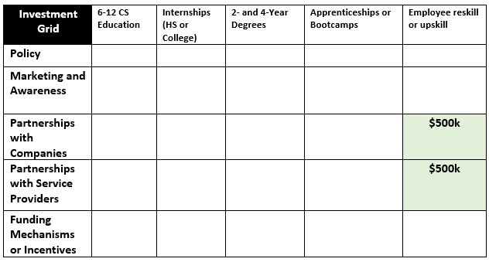
INVESTMENT APPROACH

Slide 55
LAST THING
Notes:
MNTech for Success
As we stated in earlier, we believe that choosing the tree instead of the forest is the best way to address the issue at hand. The issue facing the technology world in Minnesota cannot be solved with a single approach, but by focusing on a specific and measurable approach we can start to make a dent in the rising tech talent issues we are facing. Thank you all for your time, and we look forward to discussing further with some of you at the happy hour later!

Slide 56
QUESTIONS?
Notes:
Policy –
Get the “CS for All” policy passed. (Support for csforall.org)
Giving schools the money to implement any statewide policies that may be passed.
Marketing & Awareness
Marketing to schools to bring awareness around development options for existing teachers – awareness to existing programs
Awareness to schools about stipend for meeting student threshold
Partnerships w/ Service Providers
Not reinventing the wheel
Utilize existing programs to train current teachers & cover the cost of these programs (e.g. TEALS)
Funding Mechanisms & Incentives
Stipend for schools that get at least 10 students in their CS class (to ensure proper equipment/resources are available).

