Slide 1
Code Savvy
October 8, 2021
Christine Perrey (Seagate Technology)
Dom Smith (Target)
Kaleb Sargent (Land O’Lakes, Inc)
Merine Thomas (Thomson Reuters)
Sasha Meyer (Comcast)
Taylor Martin (Land O’Lakes, Inc)

Slide 2
Overview
Our Organization…an introduction to Code Savvy
Code Savvy’s Challenge to us
Our Approach and Focus
Our Recommendations
Benefits
Call to Action
Summary
Take home items
Notes:
Code Savvy is a Minnesota based non-profit operating as the centerpiece aimed at cultivating our kids and educators, helping to prepare and empower them to leverage computer science to support and promote an increased technological importance. Foundational to this approach, Code Savvy focuses on young people with backgrounds underrepresented in computer science.

Slide 3
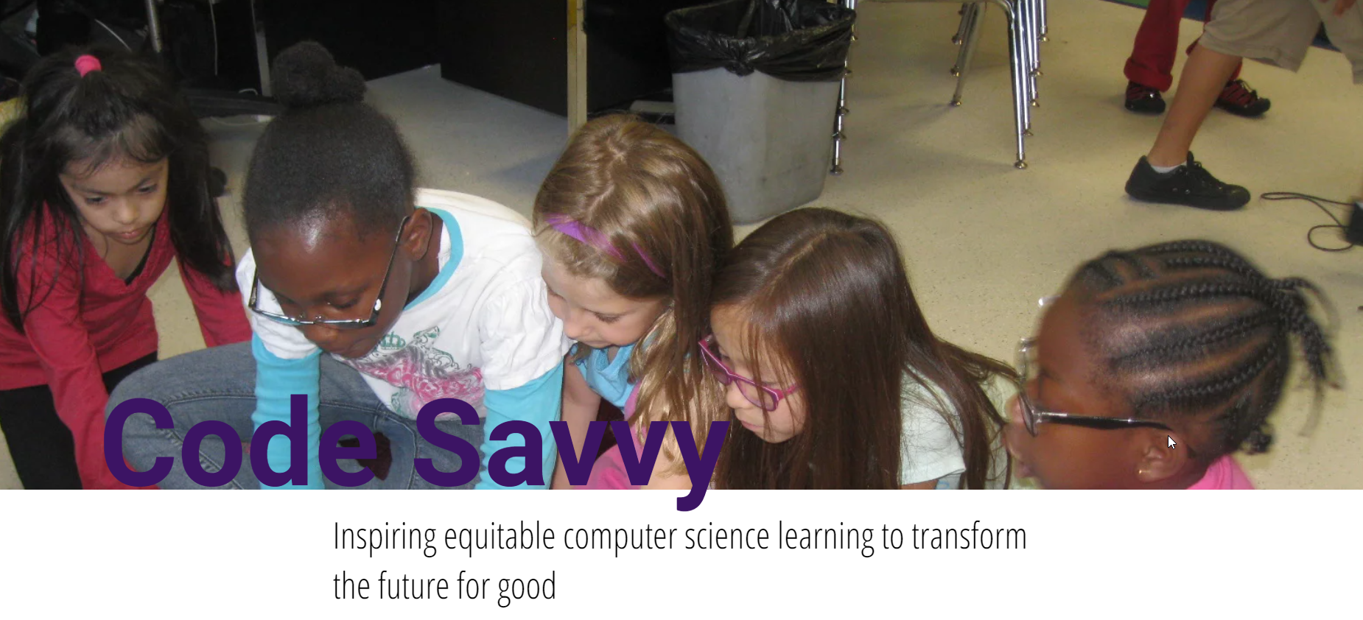
Who is Code Savvy?
https://www.codesavvy.org
Notes:
Code Savvy is a Minnesota based non-profit operating as the centerpiece aimed at cultivating our kids and educators, helping to prepare and empower them to leverage computer science to support and promote an increased technological importance. Foundational to this approach, Code Savvy focuses on young people with backgrounds underrepresented in computer science.
Mission: We interrupt and counteract existing gender, racial, and economic gaps in computing by equipping youth and educators with the knowledge, skills, and support to create with technology Vision: Inspire equitable computer science learning to transform the future for good.

Slide 4
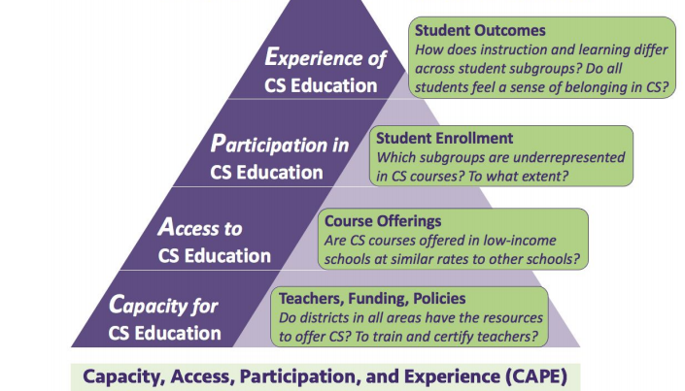
Capacity, Access, Participation, and Experience (CAPE)
Vision
Mission and Core Values (Inclusivity, Diversity, and Community)
Student programs
Educator programs
Notes:
CAPE framework has proven to be a useful tool for examining the root causes that lead to a lack of diversity in computing and has been identified and largely accepted as “A Framework for Examining Equity in CS Education.”

Slide 5
Challenge
How might Code Savvy partner with employers to create and strengthen pathways to expand equitable and engaging K-12 computer science education in Minnesota?
Notes:
How might Code Savvy partner with employers to create and strengthen pathways to expand equitable and engaging K-12 computer science education in Minnesota?
They way we thought about it – if we can solve this problem, we can solve the problem is facing trying to hire the right talent.

Slide 6
What is Code Savvy looking for?
Expanded Network
Improved Visibility
Increased Scalability
Stabilized Funding

Slide 7
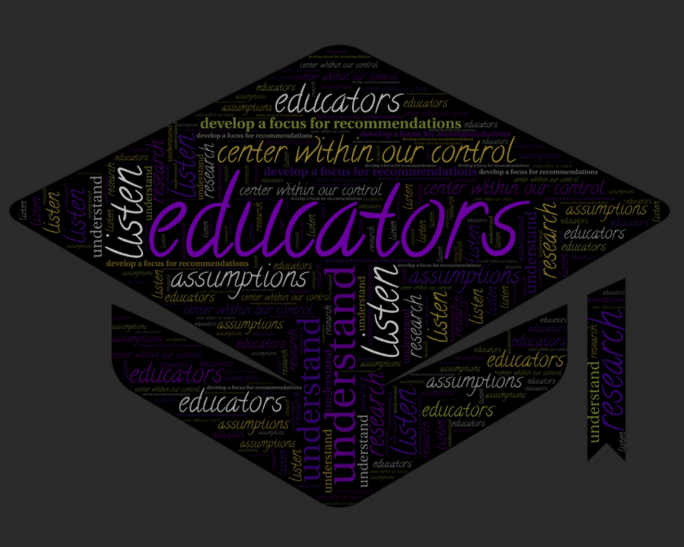
Our Approach
Notes:
2 Step approach to attacking the challenge question.
Spend time understanding the current landscape of the problem
Based on our learnings, develop a focus for our recommendations
1. Understand the landscape
Converse with Code Savvy
Hear from impacted people
Research
2. Develop a focus for our recommendations
Center around concept within our control
Establish key assumptions
Word Cloud

Slide 8
Student Stories
Notes:
This second video gathers input from current Engineering professionals that grew up in 3 different states across the nation.
As a result of where they’re from, they each have a different perspective to provide.

Slide 9
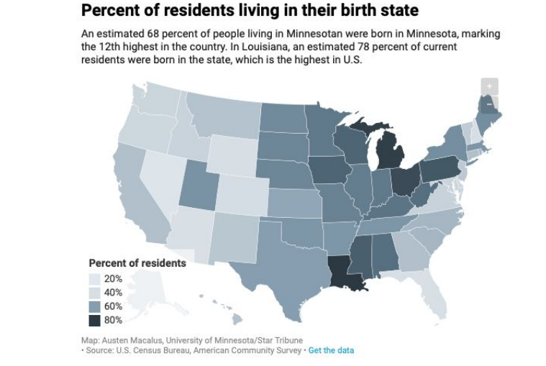
Understanding the Landscape
Students, Educators and Industry all benefit from expanded CS education in MN.
There is ongoing work to remove many of the challenges that Code Savvy face today.
CS Education standards
Educator certification pathway for CS
Broadband Accessibility
Funding to drive program scalability
Notes:
While its clear that equitable expansion of Computer Science education in MN is beneficial to Educators and students, we also found that Industry would benefit. An estimated 68% of current MN residents are born here and stay. That means we need to educate our future in Computer Science to prepare them for the workforce opportunities in the state.
Many challenges Code Savvy faces today are driven by legislation, such as
Established Computer Science standards within Education
Computer Science certification pathways for educators
Broadband Accessiblity
And lastly the availability of consistent funding, which should be more accessible given the influx of money available from the federal government with CARES and ARPA funding.

Slide 10
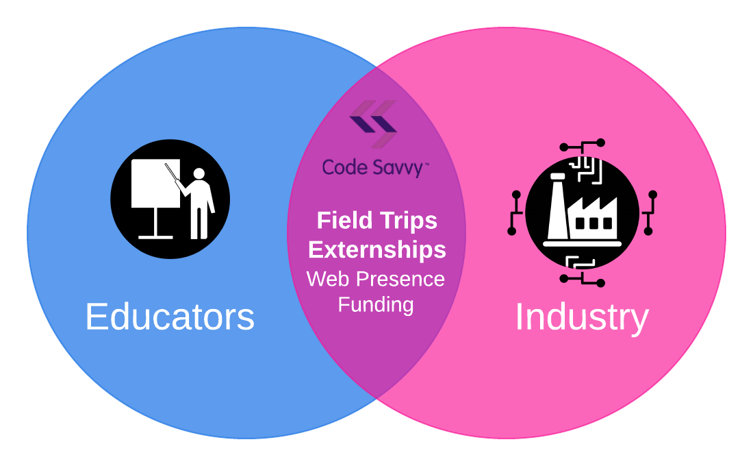
Our Focus
Field Trips
Externships
Web Presence
Funding
Educators
Industry
Notes:
We focused on leveraging Code Savvy’s ability to enable capacity for Computer Science education through their educator programs as well as drive an enhanced partnership with industry to help build the future workforce. Today we will focus on Field Trips and Externships on how they will help bridge education and industry.
I'll turn it over to Dom to talk about field trips.

Slide 11
Our Recommendations
Notes:
Code Savvy is a Minnesota based non-profit operating as the centerpiece aimed at cultivating our kids and educators, helping to prepare and empower them to leverage computer science to support and promote an increased technological importance. Foundational to this approach, Code Savvy focuses on young people with backgrounds underrepresented in computer science.

Slide 12
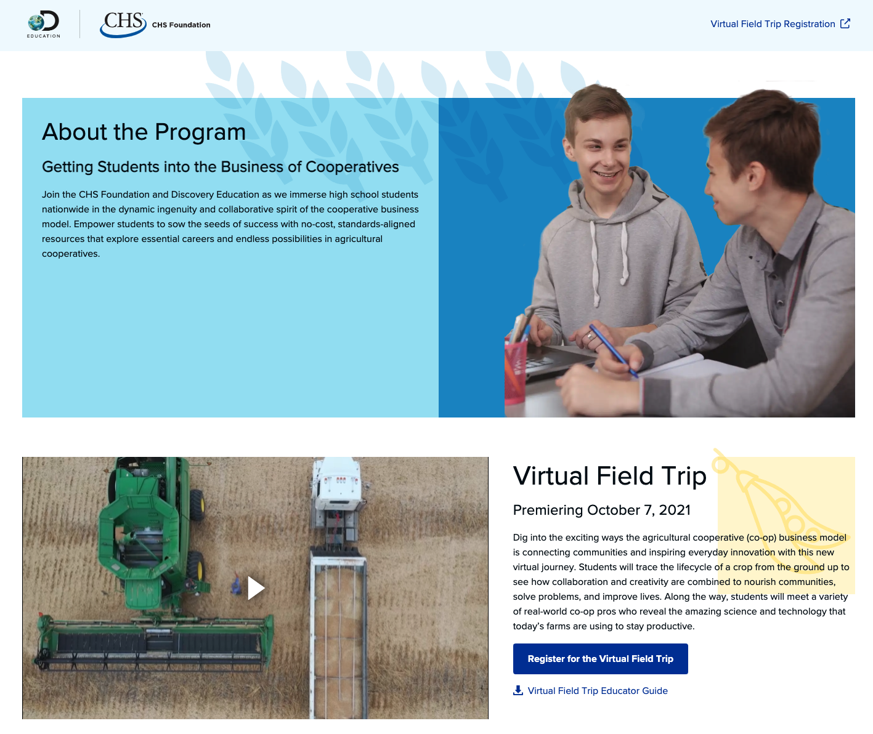
Field Trips
Code Savvy led effort to build engaging STEM/CS focused field trip experiences at participating companies.
Notes:
Images from https://www.discoveryeducation.com/info/2021-virtual-field-trips/
Corporate led online-only field trip experiences curated by Discovery.

Slide 13
Field Trips: Call to Action
Identify Corporate Partners
MnTech Board
Timeline for Workshops
Code Savvy & MnTech

Slide 14
Externships: Benefits
Educators
Industry
Overarching Opportunity
Notes:
Thanks Dom!
Our 2nd area of Recommendations to meet CodeSavvy’s Challenge is around Educator Externships.
For an Educator, providing context; a way to connect theory to practical application…. can be invaluable.
Improving practical awareness, in turn, will help educators keep and improve curriculum relevance
But Externships do not just benefit Educators.
Recall, today’s students are tomorrow’s potential employees.
It is therefore in Industry’s long-term BEST interest ----- to invest in helping to push today’s students’ thinking.
Providing relevant problems and projects, as well as adding an additional perspective for educators to draw from, will do…just…that.
Externships also provide a unique opportunity to Industry for Community involvement.
If tied to Internship programs, there’s an additional benefit of providing valuable insight from those closest to their education, as well as building into the Industry partner’s culture the importance of community involvement.
Finally, Externships provide an Overarching Opportunity; Providing a connection point for two key CS for all MN Networks: Educators and Industry. This connection can enable discovering together new potential ways to partner.
NEXT Slide please

Slide 15
Externships: Call to Action
“Impacting just one teacher allows a company to reach between 20-150 students each year.” - The Colorado Roadmap to Work-Based Learning
Industry Symposium Connection
Code Savvy
Workshop for Externship Framework
Code Savvy / MnTech
Notes:
Our Calls to Action are next steps to support Educator Externships and Code Savvy’s need for Expanded Network, Increased Scalability and Improved Visibility
1st Code Savvy should Initiate an Industry Symposium Connection
They should reach out to Industry Internship or Young Professionals programs for potential opportunities for symposium sessions with their MNCodes educator cohorts
2nd, MnTech or an Industry Partner and Code Savvy is asked to Co-host an Externship Framework Workshop. This could be a session as part of the upcoming MNCodes Summit in Nov or as a standalone workshop
Outcomes of the Workshop could include:
Suggested Guidelines for content…. with a range of options
And an outline of Website content for both MnTech and Code Savvy for connection points
NEXT SLIDE please

Slide 16
Summary
Field Trips
Externships
Web Presence
Funding
Educators
Industry
Expanded Network
Improved Visibility
Increased Scalability
Stabilized Funding
Notes:
In summary, with their established educator training cohorts, Code Savvy is positioned to be a bridge between two key networks:… educators and industry.
We propose, establishing partnerships between Code Savvy and MnTech members, to provide field trips and externships will be the MOST effective way to accomplish Code Savvy’s challenge and position them for the future
Improved visibility to the industry
Expanded network between educators and industry
Improved scalability of Code Savvy programs
Position Code Savvy for future funding (foundations and eventual legislative)
Next Slide

Slide 17
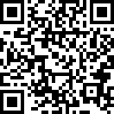
Thank you! Questions?
Please scan for a digital copy of our call to action!
https://rebrand.ly/Call2Action
Notes:
We would like to thank you for your time today.
At this point, we would be happy to answer any questions you might have.

