Slide 1
EXPANDING DREAM CORPS TECH IMPACT THROUGH NEW TWIN CITIES PARTNERSHIPS
ACE LEADERSHIP PROGRAM “DREAM TEAM” RECOMMENDATIONS TO DREAM CORPS TECH
Notes:
David
Good morning MN Tech Board, Non-profit partners, fellow ACE program participants.
I, along with my fellow DreamTeam members, are here to tell you today about a hidden gem in the tech talent industry: DreamCorps TECH.
Our goal with this presentation is to outline the powerful impact of the program for employers, participants, and the wider tech community and share recommendations about how DreamCorps can expand their impact by targeting new partnerships in the Twin Cities market.

Slide 2
INTRODUCING
DREAM CORPS TECH
DreamCorps TECH is a national nonprofit organization cultivating future leaders and entrepreneurs from underrepresented backgrounds to create a more inclusive and equitable tech sector.
DreamCorps TECH delivers their mission through four key strategic areas: Train, Engage, Change, and Humanize.
DreamCorps TECH provides in-demand technical and soft skills training to untapped talent from underserved communities.
Cohorts range from 5 participants to 30 or more. Cohort costs are supported by the corporate partners at no cost to the participant.
https://www.thedreamcorps.org/about/
Notes:
David
I think the most powerful way for you to learn about DreamCorps TECH is to hear directly from program participants. [play video]
The dreamCorps TECH arm of this company focuses almost solely on creating opportunities for underrepresented demographics to gain access to jobs in the tech industry.
They work through the approach of offering an onramp for people with non traditional tech background to secure these roles. The main way they do this is through a bootcamp program created in collaboration with corporate partners.
The programs include full technical skills training during the bootcamp, and ongoing support after graduation to help ensure success.

Slide 3
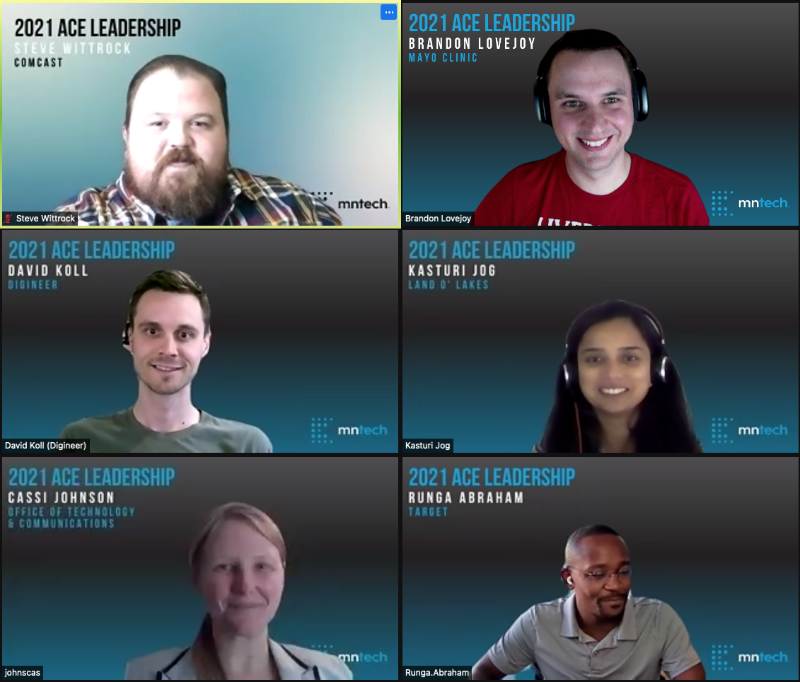
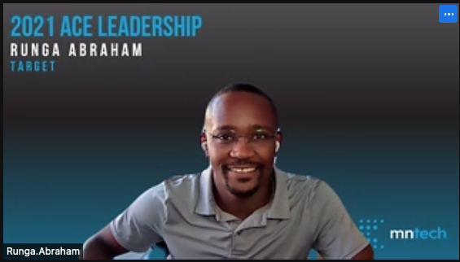
THE DREAM TEAM
Cassi Johnson- Deputy Director, City of Saint Paul IT
Kasturi Jog - IT Manager, Land O’ Lakes
David Koll - Consultant, Digineer
Steve Wittrock - Operations Manager, Comcast
Runga Abraham - SEM, Target
Brandon Lovejoy - Lead Systems Engineer, Mayo Clinic
Notes:
David
That was a little bit about our company, here is a little bit about our team
Here you have the DreamTeam Members. Our team brought a diverse background and different perspectives into this project, so we are happy to be here and share with you today. You will get the chance to hear from each of them today.

Slide 4
PROJECT OBJECTIVES
•Deliver insights that lead to increased volume of insights that lead to increased volume of bootcamp partnerships
p partnerships
Deliver Insights that lead to increased volume of bootcamp partnerships
How does DreamCorps Tech get corporate partners to see value in the program?
What types of ROI should be presented to potential partners?
What are tech leaders looking for in an engineering program? How can DreamCorps distinguish themselves?
Notes:
Brandon
We were tasked by DreamCorps TECH leadership to deliver insights that lead to increased volume of corporate partnerships in the Twin Cities market.

Slide 5
OUR APPROACH
CURRENT STATE ANALYSIS
BOOT CAMP/ TECH DIVERSITY MARKET ANALYSIS
DEVELOP RECOMMENDATIONS
DELIVER
Notes:
Brandon
In service to those three objectives, we sought to:
Understand the value companies seek through partnership with a software engineering bootcamp program
Identify the skills and behaviors partners seek in emerging tech talent
Identify what companies need to know to understand the value of the DreamCorps Tech program
Identify the data DreamCorps Tech should track to understand and communicate Return on Investment
Deliver program design and marketing recommendations DreamCorps TECH can use to expand corporate partnerships

Slide 6
ANALYSIS OF DREAM CORPS CURRENT STATE
Strengths
Unique approach to bootcamp.
Impact:
On participants: New careers started in Tech
On corporate partners: More Diversity and Inclusion. Added workforce pipeline.
On Community: Providing equitable opportunities to the underserved.
Large pipeline applicants looking to enter bootcamp.
Courageous applicants, large pool of self-starters.
High retention rate of placed graduates
Weaknesses/ Gaps
Lack of help support and develop talent post-hire.
Heavy reliance on corporate partner for bootcamp engagement
Long discovery and curriculum creation timeline
Lack of local marketing presence
Lack of process to efficiently screen large quantities of candidates
Notes:
Runga
Our current state assessment of DreamCorps TECH, we identified significant strengths and assets to build upon, but also some gaps that the organization can address to increase impact.
Success story
In 2020 Dream corps tech had 2 bootcamps with UHG and Target as corporate partners. Their bootcamp with Target for 2020 had 19 participants and at the end of the program 14 of the participants were offered full time engineering positions.
In 2021, Target and Dream Corp Tech have another bootcamp starting on Monday October 11 with 20 participants selected from 122 applicants. There is a HUGE interest in this program.
Strengths:
Amongst the greatest strengths of the program is it’s unique approach to bootcamp. The program focuses on non-traditional tech talent and early career individuals, is offered at no-cost to participants, and is developed in tight partnership with the corporate partner.
The program also has a three-legged stool of impact with benefits accruing to participants, corporate partners, and the community.
Finally, in a tough tech talent market, DreamCorps has a large pipeline of courageous, self-starter applicants waiting to begin their careers.
Gaps:
The gaps we identified for the program are the lack of support to develop talent post-hire, the long and time-intensive process of developing the bootcamp relies on strong partnership with the corporate partner, and the lack of capacity and marketing support to capitalize on the opportunity in the Twin Cities marketplace.

Slide 7
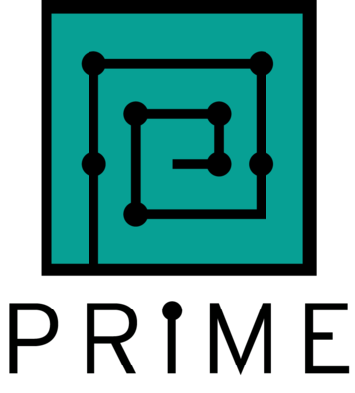
MARKET ANALYSIS FINDINGS
Direct Competitors - Offer corporate and enterprise training, but more general
Indirect Competitors:
Contract and temp-to-hire agencies
Recruiting Agencies
Internal Hires
Notes:
Runga
The final component of our SWOT analysis was a look at threats to the program, in the form of direct and indirect competitors.
We identified Direct competition in other Non-profit tech recruiters, and Other technical bootcamp providers such as Genesis10, Prime, Software Guild
We also recognize that there are many different ways companies identify tech talent that need to be considered as indirect Competition: Like Contract and temp-to-hire agencies, Recruiting Agencies, and Direct Hires

Slide 8
OUR RECOMMENDATIONS
CORPORATE PARTNERS
Expand profile of targeted sponsors & empower with tools to advocate for the program.
MARKETING
Marketing to expand awareness and convey value.
ORGANIZATIONAL READINESS
Expand offerings focused on culture & organizational readiness, with a focus on retention
SKILL DEVELOPMENT
Expand skill development to include CS fundamentals & non-technical IT career paths
Notes:
Runga
In response to our current state analysis, we developed a series of four recommendations that are intended to build on DreamCorps TECH’s assets and address gaps to increase the impact of this important program.
[@Runga do not read the recommendations from the slide- let it just stand as an introduction/ transition to what’s to come]

Slide 9
RECOMMENDATION #1:
EXPAND PROFILE OF POTENTIAL SPONSORS
Use corporate and buyer profiles to build prospect list
Increase connections to IT leaders in the Twin Cities
Network with mid-level managers and provide the tools they need to create a business case inside their companies
Market a shared value approach to build partnership across IT, HR, and Corporate Philanthropy/ Corporate Social Responsibility
Offer Collaboration model cohort for common needs across companies
Is there opportunity in the government/public sectors?
Notes:
Kasturi
Our first recommendation is that DreamCorps TECH increase the pool of potential sponsors in the Twin Cities who can serve as an entry point to partnership.
Today DreamCorps connects with leaders in the Diversity, Equity, and Inclusion roles. We recommend that DreamCorps broaden their reach within IT leadership, connect to more mid-level managers and provide them the tools to build a business case for partnership.
We also see an opportunity for “shared value” approaches to partnership, where IT, HR, corporate foundations, or corporate social responsibility leaders all contribute resources to the DreamCorps partnership in recognition of the multiple benefits that accrue to each of these areas. Advancing a “shared value” approach may require new marketing materials and guidance to leaders about how to build a case for a shared value investment.
We see opportunity for a collaboration model that could be hosted by a trade organization, foundation, chamber, etc to share the lift required to plan and implement the program as a partner and to allow companies that may have a smaller tech workforce to participate.
Finally, DreamCorps has focused mostly in the private sector. We suggest additional discovery with potential non-profit and government partners to understand the unique needs and constraints in these sectors.

Slide 10
DREAM CORPS - CORPORATE PARTNER PERSONA CANVAS
Corporate Persona
Medium to large size business.
Strong presence in MN Twin cities.
Large number of tech employees (1000 +)
Goals
Build diverse pipelines for workforce.
Recruiting Process
Contract and temp-to- hire
Internships
Direct Hires
Corporate Thinking
College degree vs skill-based hiring.
Investment (Time and money)
Benefits of diverse teams
Recruit for self-starters
Why Invest
Build diverse talent
Drive retention
Contribute to community
Reduce cost of diverse hires.
Initiatives
DEI Emphasis for organizational culture.
Talent development initiatives like ‘Emerging engineers’ or ‘Tech for all’
Timing
Budget planning cycles.
Utilization of allocated budget.
Channels
Recruiting firms, Job fairs, College recruiting, Job postings, Technical bootcamps, Consulting firms.
Influencers, stakeholders
CXO’s (Chief Technology/ Information /Cultural / People Officer)
HR and recruiting teams.
Mid-level people managers, Hiring managers
Content and Information
Industry Outlook: Average cost to hire; Technical hiring shortage.
Success stories
Partnerships through tech associations
Notes:
Kasturi
In order to maximize sponsor impact with limited marketing and outreach resources, we recommend DreamCorps build out the practice of developing personas to help inform marketing and strategy. Here we have included an example corporate partner persona canvas but others could be developed to target different industries and kinds of stakeholders.

Slide 11
RECOMMENDATION #2:
MARKETING TO EXPAND AWARENESS AND CONVEY VALUE
Value Proposition:
Benefits of diverse teams
Reasons why price is “worth it” : Impact
Compare to market average – 20k to hire any employee, 3x for diverse candidate
Community benefits
Advertising:
Feature success stories
Target buyers
Social media
Free or reduced cost advertising channels for non-profits
Networking: Tech conferences, user groups (vendors, etc.), non-profit agency partnerships, job fairs
Notes:
Kasturi
Our second recommendation is to hone the marketing message and expand advertising to reach more potential sponsors and to convert them to corporate partners.
We recommend new messaging specifically focused on DreamCorps TECH’s value proposition. We know the cost of recruiting and retaining tech talent especially diverse tech talent is high, and DreamCorps TECH offers significant value to hiring managers PLUS community benefits that can be leveraged for marketing and communications as well.
DreamCorps TECH has very moving and impactful stories in their material, and can explore free advertising channels like Google Non-profit or network through association memberships, user groups, and conferences to reach more potential sponsors.

Slide 12
RECOMMENDATION #3: EXPAND OFFERINGS FOCUSED ON CULTURE & ORGANIZATIONAL READINESS
DEI consulting focused on training, skill-building, and cultural change is an $8 billion per year industry.
A former Dream Corps participant identified DEI- skilled organizational leadership and team structures that help support and develop talent post-hire as key ingredients for success in retaining diverse and non-traditional tech talent.
Leverage expertise in DEI to help companies prepare for success in leveraging diverse and non-traditional tech talent. This consulting support may tap different organizational resources than IT talent recruitment, add value to the Bootcamp programming, and support talent retention.
Integrate graduates with support on teams
“Bootcamps can turn out perfect candidates, but companies have to be ready to receive them.”
Notes:
Cassi
A former Dream Corps participant identified DEI- skilled organizational leadership and team structures that help support and develop talent post-hire as key ingredients for success in retaining diverse and non-traditional tech talent.
They said, “Bootcamps can turn out perfect candidates, but companies have to be ready to receive them.”
We recommend that DreamCorps consider expanding their DEI cultural and organizational change consulting offerings. This would enable them to leverage their expertise in DEI to help companies prepare for success in leveraging diverse and non-traditional tech talent. This consulting support may tap different organizational resources than IT talent recruitment, add value to the Bootcamp programming, and support talent retention. A study by McKinsey identified that the DEI training industry is an $8 billion dollar per year industry.
In additional to expanding training offerings like the Unconscious Bias training already offered, DreamCorps could provide organizational development support around how to integrate recent graduate within teams, onboarding procedures, competency level expectations, cross-cultural collaboration, and more. This support could bring additional revenue, add value to corporate partnership, and support outcomes around retention.

Slide 13
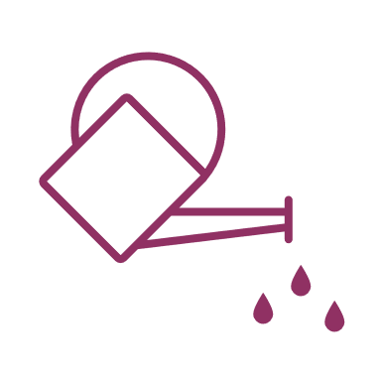
RECOMMENDATION #4:
EXPAND SKILL DEVELOPMENT OFFERINGS
More focus on fundamentals and developing “teachable” tech talent that can expand into different programming languages and IT fields.
Expand offerings to include Analyst (BA), sales, QA, Scrum, System Admin, UX Design, etc. –
Wider talent pool
Notes:
Steve
We also believe that expanding skill development offerings may help DreamCorps TECH expand corporate partnerships.
Furthermore, we know from our own organizations that development is just one path into a tech career and that many companies are also struggling to recruit and retain high quality talent in business analyst, scrum, system admin, user experience, and other roles. DreamCorps TECH could expand potential corporate partnerships and reach a wider potential talent pool by expanding skill offerings.

Slide 14
THANK YOU FROM THE DREAM TEAM
Notes:
Cassi
Thank you for the opportunity to highlight the value of work by Dream Corps. We hope that these recommendations are useful to the organization as they seek to expand impact in the Twin Cities. We know this work is valuable and very much needed in our community.
For the MN Tech Board members here today, we ask you to take a meeting with Kasheef and DreamCorps to learn more about the program. Even if you aren’t currently seeking this kind of partnership, your connections and knowledge about our local market would be invaluable and you can learn about opportunities to contribute.
MN Tech Board members, can you please raise your hand (virtually or on screen) if you are willing to take an informational meeting with DreamCorps staff? Kasheef, take note of the new potential supporters and let us know if we can help you connect in any way.
Thank you all so much for your support.
10/3 DK Note: The demand for this program is exploding for tech talent. In the latest cohort alone, DreamCorps Tech had 136 applicants, but there are only 26 seats to fill. There is so much opportunity, but not enough leaders and companies at the table to meet the demand.
These are people with incredible drive and strong technical background that can offer so much value to potential partner companies. Our ONE Ask of you: Can we introduce the talent to your companies? There is an incredible pipeline here, and now is the time to capitalize on the opportunity to fill open positions with talent that has loyalty to the company while we go these times when retention and hiring top talent is proving incredibly difficult. DreamCorps has over 100 people that are waiting for their next opportunity.

