Slide 1
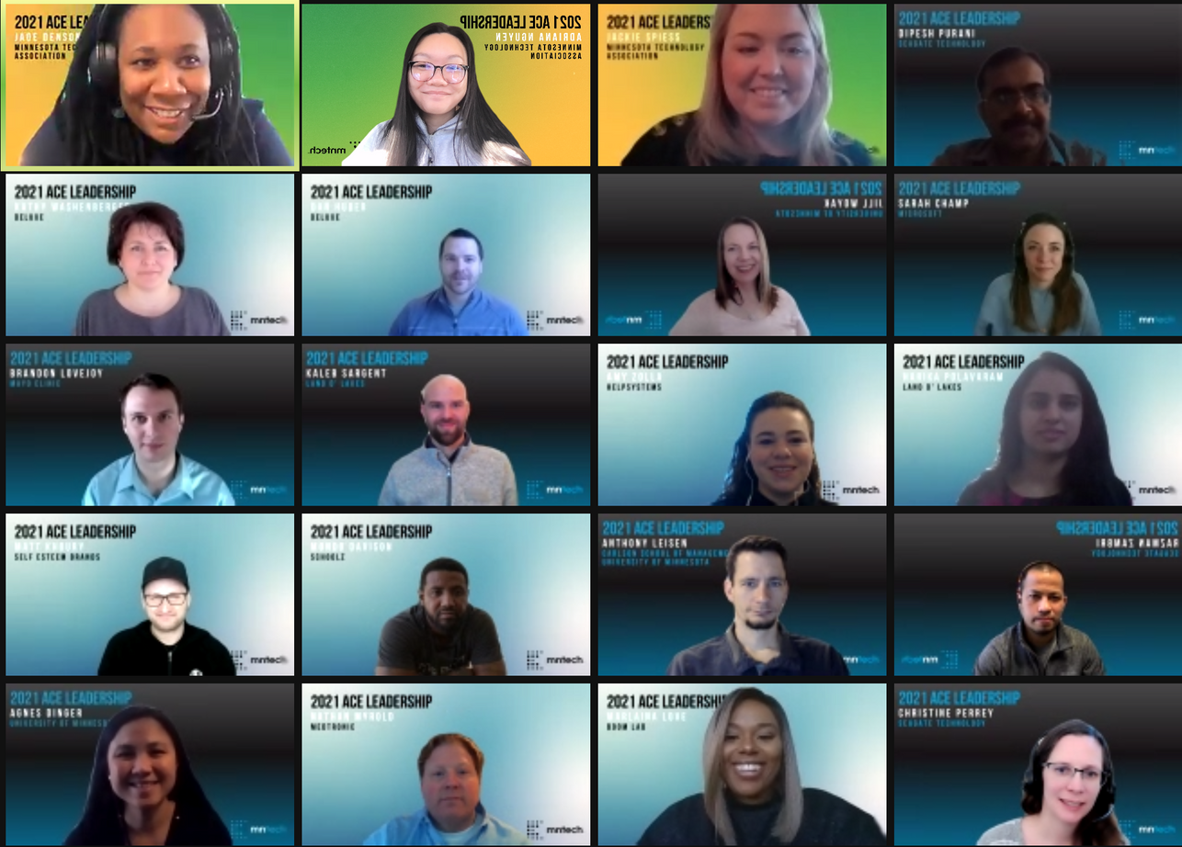
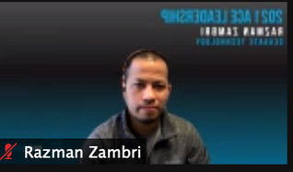
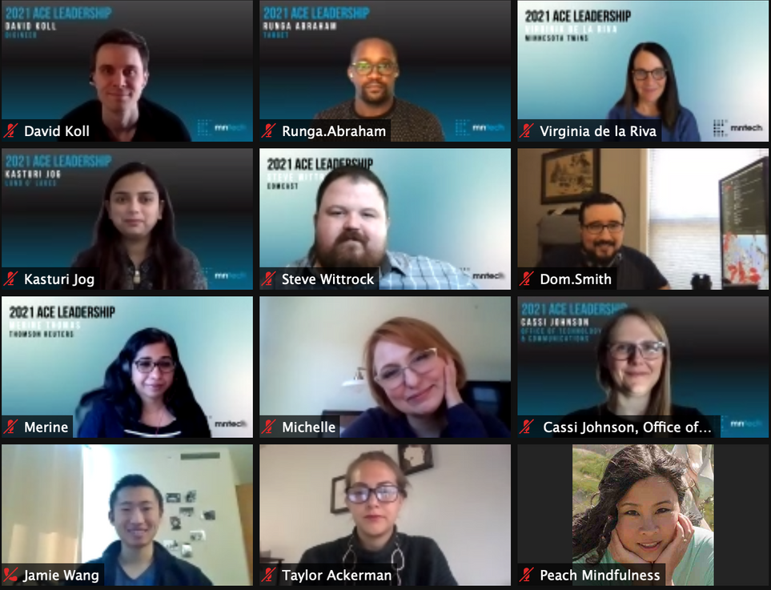
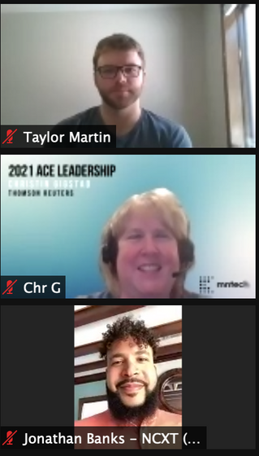
MINNESOTA TECHNOLOGY ASSOCIATION
2021 ACE LEADERSHIP
SMALL GROUP PROJECT
Notes:
Taylor

Slide 2
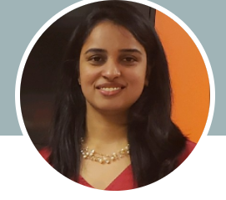
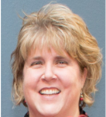
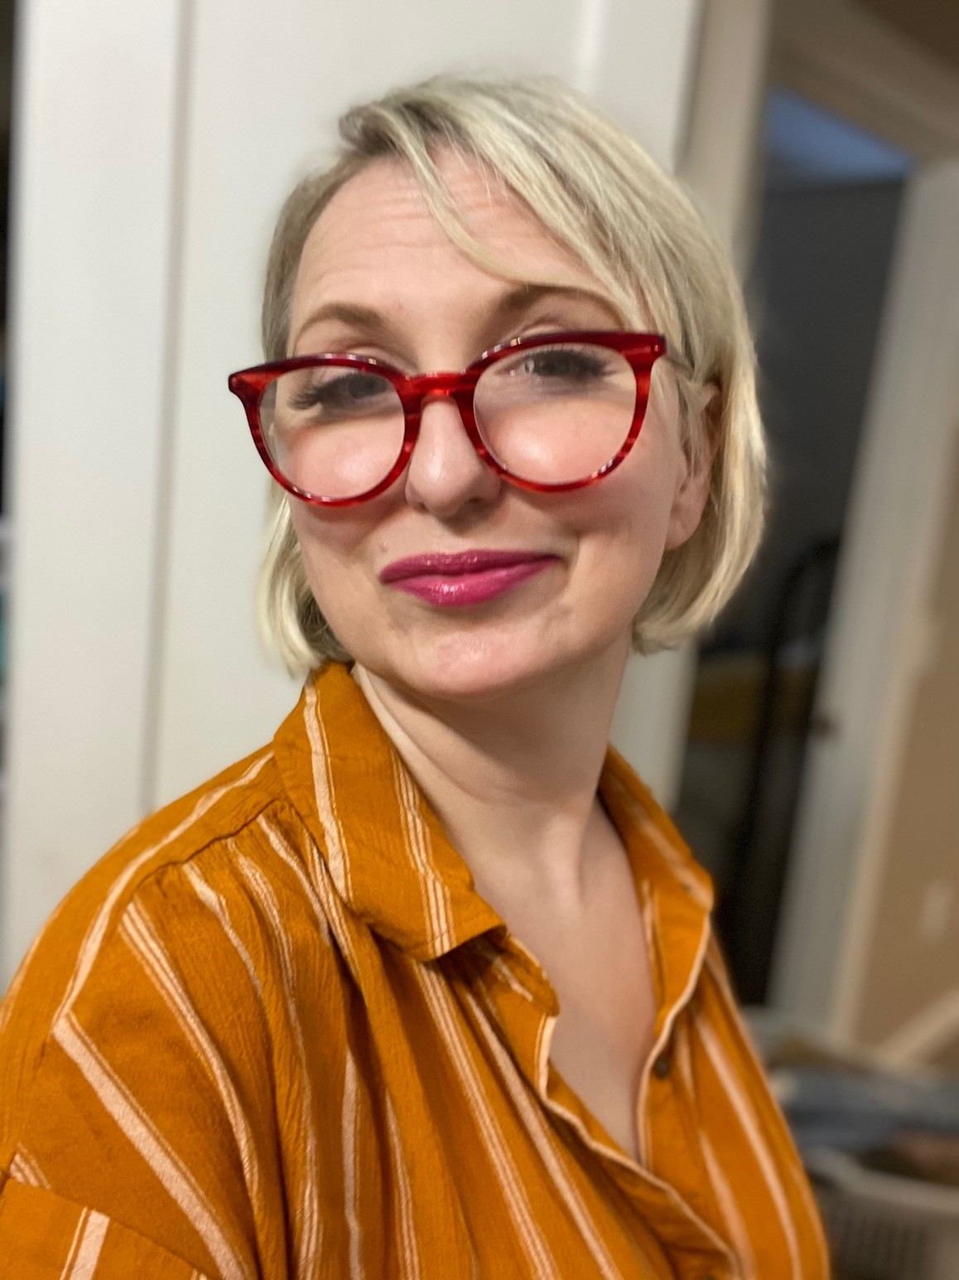
Team Members
 | Harika Polavaram IT Manager, Sales & Marketing Land O'Lakes, Inc., one of America's premier agribusiness and food companies, is a member-owned cooperative with industry-leading operations.
 | Christin Gigstad Delivery Manager Thomson Reuters is the world's leading source of news and information for professional markets.
 | Michelle Leisz SAP TM Manager CHS, a global 100 fortune agribusiness owned by farmers, ranchers, and cooperatives across the US \
ORGANIZATION INTRODUCTION
Notes:
Christin Blue , Yellow, Gray

Slide 3
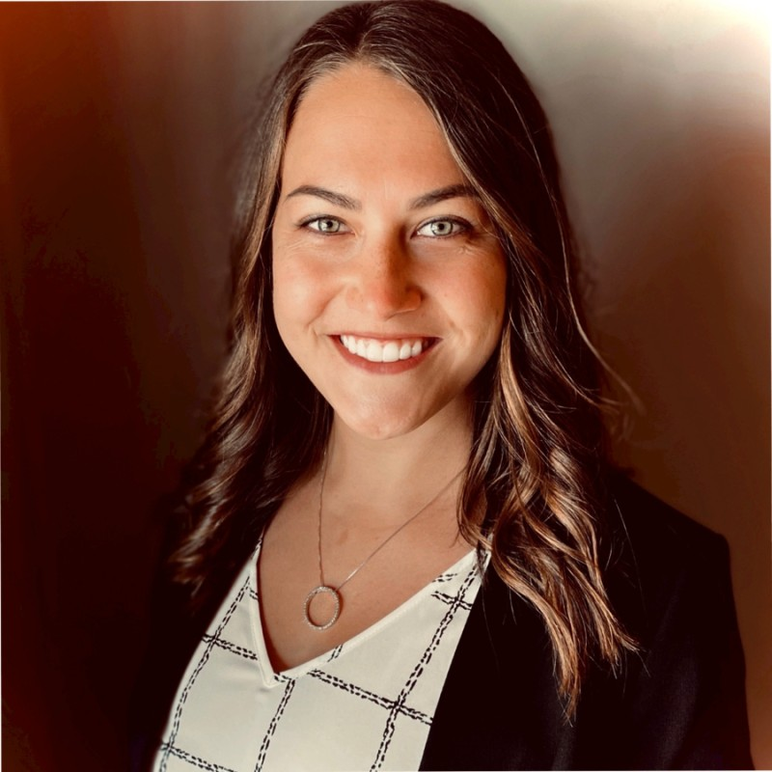
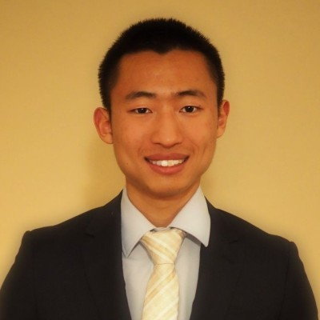
Team Members
 | Marlaina Love Software Project Manager Danfoss engineers' technologies that empower the world of tomorrow to build a better future
 | Taylor Ackerman Management Consultant Digineer is a management consulting that has extensive knowledge in leading projects and improving business value.
 | Jamie Wang Technology Consultant Kin and Carta is a technology consulting firm focused on social impact and deriving value from technology
ORGANIZATION INTRODUCTION
Notes:
Christin
Through research, analysis, and experience, ACE leaders identified several areas of improvement.
The key technology strategies that are shaping organizations.​
​The skills & talent businesses need to support their objectives.​
​Recommendations to consider when preparing high school students for successful internships and careers in technology.

Slide 4
MN State it Center of Excellence Technology skills for the future
Enhancing Education
Inspiring Students
Engaging Industry
About
Notes:
Marlaina
The Minnesota State I.T. Center of Excellence encourages Minnesota youth and adults to pursue careers in I.T. and computer science. Through collaboration with the tech industry with their partners, and high school and college educators; the Minnesota State IT Center of Excellence seeks out, develops, and provides low or no-cost resources that teach relevant, high demand, and applicable I.T. workforce skills.

Slide 5
Scaling PowerUp IT Program Virtual Professional Development Series for High School students
Maximize Value for Youths
Increase Program Effectiveness
Provide Recommendations
Problem Statement
Notes:
Michelle
PowerUP IT program, a program whose purpose is to empower BIPOC and at-risk youths to engage in a career within IT. Through this program, the Minnesota IT Center of Excellence provides information sessions, networking opportunities, and other help for youths to better explore what IT means as a career path and its potential benefits.
We have been asked to support the Minnesota State IT CoE initiative in scaling this program, which will enable them to reached more student and schools, expanding talent pipeline.
The purpose of the collaboration is to address several items within this program:
How do maximize value for youths?
How do we increase the effectiveness of this program in engaging youths with the IT industry?
What general recommendations can be provided for this program?
Removed
What entry-level technical & non-technical skills are MN IT employers seeking, particularly for cybersecurity, software development, and data science roles?
What steps can be taken to develop partnership with businesses?

Slide 6
HOW WE APPROACHED THE PROBLEM
Internal Research
Defined Problem
Conducted Brainstorm/Ideation Sessions
External Research
Leveraged Internal Network Groups
Conduct Market Research
Recommendations
Aggregated Data & Impact Analysis
METHODOLOGY
Notes:
Michelle
Alignment / clear understanding of the problem
created a weekly cadence in which to review and incorporate information regarding the PowerUP IT program
explored what the program was, its intended purpose, as well as the challenges facing it
Brainstorming / ideation
conducted validations of our brainstorming sessions (weekly in agile manner)
further align our recommendations to the vision of the PowerUP IT program and continuously incorporate feedback from our business stakeholders
Leverage our network of ERG, HR, and hiring managers
Heightened awareness of diversity & inclusion / MN High School under-representation
How can we help spread awareness / become part of the solution

Slide 7
A tighter coupling between 3 stakeholder groups to add value
Partner Programs
Corporations
Students
OUR
RECOMMENDATIONS
Establish a formal value proposition
Ensure long-term goals are met
Communicate the value to candidates
Notes:
Jamie
Align MyProfile tool to customer needs (whether customer is a company or Geosysworks or etc.)

Slide 8
Establishing a formal value proposition
The PowerUP IT program should position itself as a “feeder” for organizations dedicated to placing young talent in technology internship programs
Partner Organizations
Youth Talent Pool
Online Student Profiles
Single-click or Auto-enroll*
OUR RECOMMENDATIONS
Value:
Provide structured value to youth talent
Fulfill need within partner organizations
Leverage existing infrastructure within the IT talent promotion ecosystem
Work Required:
Formalize partnerships with individual organizations
Integrate PowerUP IT via API calls to individual organization systems
Notes:
Jamie
Align MyProfile tool to customer needs (whether customer is a company or Geosysworks or etc.)

Slide 9
Ensure long-term goals are met
The PowerUP IT program should provide guidance to ensure the youth talent is able to position themselves optimally for full-time employment
Resume Generation / Guidance, Interview Guidance, Steps to Build a Stronger Resume
1
Speak the same language
2
Highlight the 5 E’s
3
Acquire relevant certification
IT Buckets
Data Science
Web Development
UI/UX Developer
BSA/Project Management
Middleware Integrations
Cybersecurity
Network/Cloud Infrastructure
Content Editor/Contributor
Relevant Items
Education
Experience
Eagerness
Empathy
Extracurricular Activities
Field | Key Certifications
Data Science | Certified Analytics Professional (CAP) Data Science Council of America (DASCA) Google Certified Professional Data Engineer Google Data Machine Learning Microsoft Certified Azure Data Scientist Associate AWS Certified Data Analytics
OUR RECOMMENDATIONS
Value:
Provide disadvantaged youth with a level playing field in “blind” hiring
Teach communication methods for corporate America
Work Required:
Further enhance market research to create optimal resume presentation
Create a training program or utilize an IT solution to build out “corporate” resumes
Notes:
Taylor
Align MyProfile tool to customer needs (whether customer is a company or Geosysworks or etc.)

Slide 10
Communicate the value to candidates
Use the new structured value proposition to advertise PowerUP IT to potential candidates of the program
Partner Organizations
Corporations
Utilize graduates from partner organizations to speak about their experiences and encourage the next generation to go through the PowerUP IT program
Connect corporate outreach / ERG (employee resource group) programs to youth talent through the partner organizations with established connections to these corporations.
OUR RECOMMENDATIONS
Value:
Bring in a relatable speaker to share their excitement about internships
Minimal work required from both parties
Opportunity for partner promotion AND PowerUP IT promotion
Value:
Bring in experienced speaker to share their excitement about technology
Chance for corporations to promote themselves to next talent pool
Work Required:
Connection to corporations through partner organizations
Collaboration with outreach groups
Work Required:
Connect speakers to PowerUP IT program
Notes:
Jamie
Align MyProfile tool to customer needs (whether customer is a company or Geosysworks or etc.)

Slide 11
Thank you!
Closing
Questions
Feedback
Notes:
Christin
In Closing, as a co-lead of an employee resource group at Thomas Reuters, I know firsthand the impact what an ERG can do for not only a company, but for a company.
This highlights DEI for …

