Slide 1
ACE 2020 Project: PCs For People
September 17, 2020

Slide 2
Presented by
Seagate Corporation
Ravi Nadimpally
Eric Grose
Comcast
Wade Navratil
Minnesota Twins
Mayo Clinic
Amy Liu
Larry John
HelpSystems

Slide 3
Table of Contents
State the issue
Approach and process
Seagate real life example
Website
Ideas/suggestions
Roadblocks

Slide 4
State the issue
Getting to the correct person
Perception of non-profits handling data & R2 and NAID AAA correctly
Competing with Companies recycling equipment for profit
Infiltrating into larger organizations
Notes:
#1 from TOC
the project request was about getting PC’s for People into larger organizations. We understanding that PCS4People is having issues infiltrating into companies of 5000 plus people, by infiltrating these companies for recycling will give you more equipment at one stop. Barriers we heard were the following: getting to the correct person, recycling electronic equipment for profit, non-profit perception of handling NAID AAA and R2 certifications correctly.

Slide 5
Group approach and process
Website story
Interview our own company plus 1 other larger organization
Additional Organizations to Partner with to Generate a Stronger presence
Notes:
#2 from TOC
Our approach: We each interviewed with our own companies and tried to interview another larger company. We all happened to work for a bigger sized company that you are interested in. So that helped.
Our focus: Recognizing that your goal is to expand into the 5000+ employee sized companies, we kept that goal in mind from the beginning, and made our focus to be a proposal on “the pitch to bigger companies”.
What’s in progress: We are especially focusing on the “story”, and the beginning of the story as to how to open the door with the big companies.
Interview our own company plus 1 other larger organization.
Website Story
Additional organizations to tie into

Slide 6
Seagate case study
Looked into the possibility again as Seagate is closing a site in Shakopee
A single e-waste vendor?
HDD removal?
Data security is paramount for big companies. What else can be done to convince them?
Extra help?
Donations are handled by "volunteers" within the company. Extra help such as packaging are appreciated
Unique challenge for big companies
Contacted Seagate again
Notes:
#3 from TOC
Looked into the possibility again as Seagate is closing a site in Shakopee
A single e-waste vendor?
If a single e-waste vendor can be guaranteed by PCFP and qualified by Seagate, then both working and non-working equipment can be donated, maximizing usable equipment by PCFP, and increasing the chance for business
HDD removal?
Most big companies still choose to remove HDD for 100% data security. What else can be done to convince them?
Extra help?
Donations are handled by "volunteers" within the company. Help from PCFP such as packaging would be appreciated
Introduce Ravi for the website

Slide 7
Website
Speed
Design
Marketing
Opportunities
Notes:
#4 from TOC
Speed of the website loading
When the website is open from Desktop it took 8.57 seconds to load
When the website is open from 3G/4G enabled mobile device it took any where from 8.5 seconds to 11 seconds to load
Design of the website
Responsive design
There is a need for partner portal for larger organizations
The website need to be secure by Design – Currently it is opening several new windows and taking the website users to different locations
Donate link - https://pcsforpeople.z2systems.com/
Renew Internet, Buy Online, - pcsrefurbished.com
Re-arranging the website deign
Marketing
Advertise social media presence in the correct location, Facebook link is way down
Opportunities
SEO (Search engine optimization techniques to come up PCs4people in the correct search)
Pcs4people.org and switching to pcsrefurbished.com
Finding a developer – opportunity
4 hours development opportunity

Slide 8
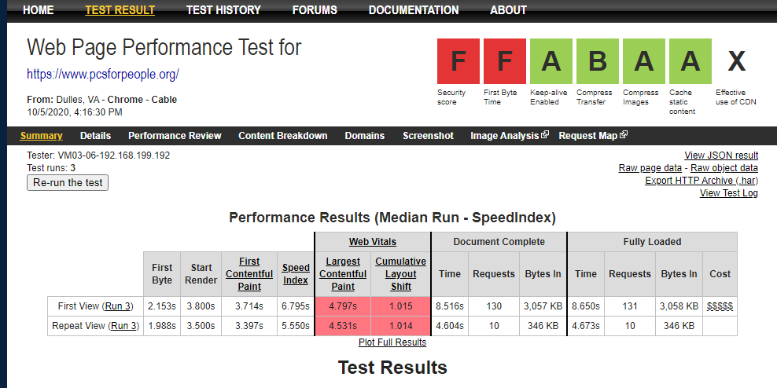
Website Testing
Notes:
#4 from TOC
Speed of the website loading was tested in https://www.webpagetest.org/, which is a free tool to test the website speed from multiple locations around the world with real browsers and different internet connection speeds. This website also give an option to test these from mobile devices using different data speeds. It also gives the video recording of the test so that for debugging purposes we can watch the video at different points.
When I tested PCS4people using webpagetest.org it gave the following statistics
When the website is open from Desktop it took 8.57 seconds to load
When the website is open from 3G/4G enabled mobile device it took any where from 8.5 seconds to 11 seconds to load
There will be detailed events like, processing categories and processing events show how much time it took for scripting, layout, painting of the website, loading and other activities.
The other detailed view include performance review, content breakdown, domains, processing breakdown, screen shots, image analysis and request map
Image analysis - will let you know the Page image Score (A, B, C, D etc), if you get the score of A then it is good. Otherwise it will give recommendations of existing image weight and potential compressed weight.
Details tab will give complete details of the webpage loading in a water fall method, this include how much time taken to load each of the background components in the webpage (example css files, script, images, videos etc)
Introduce Eric with Pitch to large organizations

Slide 9
Pitch to large organizations
Face for the brand
Understanding true mission
Value
Vision
What is it for the big companies
Social media presence
Infographics
Building Name recognition
Notes:
Story, value, free and good publicity (Eric)
Make your Value known and speak to heart not business
What is Story ? Vision- Should this be highlighted on website and or during pitch to others?
What's in it for the large orgs –What are there wins Outside of a tax deduction (Why is Pc's for people a good partner)
Building name recognition (Eric)
Voice for your Brand (who speaks for you)
Infographics(Show how what you are receiving is helping the community)
More Presence on social Media (919 followers Instagram) Twitter, Facebook –I.e. Easy access to you
Use social media as another member or Public relations(free)- Create more of a buzz about your efforts and accomplishments
Introduce Wade with Ideas and suggestions

Slide 10
Ideas & Suggestions
Introduced to LEED certification group
Right Contacts – Building managers vs CIO’s
Less than perfect goods
Notes:
#5- from TOC
At Target Field we pay a lot of attention to our LEED certification and sustaining the levels that we have reached. LEED means LEED (Leadership in Energy and Environmental Design) - Diversion rates for all recycling --- one group that we belong to in this area is called --- Environmental-initiative.org within this organization The Sustainable Growth Coalition is advertising PC 4 People to its members on their team site.
We all attend conferences -
Getting to the Right contacts --- diversion/recycling rates for large companies may not be the CIO/IT Dir’s. We suggest that you also include Building Operation/Building Maintenance /Facility directors/managers in your reach outs. One example of this is Environmental-initiatives --- at the next Materials Team meeting will be discussing PCS4People
Charitable arm --- Work with the community/charitable arm of the company for a recycling drive(use larger company parking lot, employee list) to get the PC4People name out --- update your Guidestar profile --
Less than perfect goods --- contact component manufacturing for non-saleable products or returns (ie. Geek squad, Seagate, Western digital,etc)--- Environmental-Initiatives discussing with Best Buy for possible partnership.

Slide 11
Ideas & Suggestions
Charitable arm
Sponsor Tech rooms at other non-profits
Explain, Define and Update your UN Sustainable Development Goals
Notes:
#5- from TOC
,
Tech rooms --- Sponsor tech rooms at charities to help people get to the work force. Catholic Charities, Mary’s Place etc…
As people volunteer at these facilities, they will take notice
Possible to use some donated network gear
Possible to use some larger donated equipment
UN Sustainable development goals --- PCS 4 People impacts 6+ of the 30 goals
Charitable arm --- Work with the community/charitable arm of the company for a recycling drive(use larger company parking lot, employee list) to get the PC4People name out --- update your Guidestar profile --
Guidestar website is a place where the charitable arm of larger companies research the non-profit – mission statement, assets, who they are, board of dir, etc… They use this as a validation as to the fit within the donating companies' values.
https://www.guidestar.org/profile/26-2066045
Introduce Larry with additional suggestions

Slide 12
Ideas & Suggestions
Large donors focus on two areas when selecting a vendor
Service
Mission
Costs
Local impact
Aligned values
Consumer
Data Destruction
Environment
Liability
Location Servicing
Large Quantity Donations
Target mission
Employee
Notes:
As mentioned earlier, part of our research was to reach out to larger organizations to determine what criteria they used when evaluating Recycling and e-Waste vendors. We found that they primarily focus on 2 main areas: The services provided and the overall mission.
With regards to service they are concerned about Data Destruction, Environmental Impact, Transfer of Liability, Ability to service all office locations, Ability to process large donations, and overall cost. With regards to mission they focus on making an impact to their local community, the alignment of both donor and vendor values, and who the mission targets. Is it the individuals working at the recycling center, the consumers, or some other group or demographic?

Slide 13
Ideas & Suggestions
Costs – No costs to donor even for outdated or non-working electronic equipment
Data Destruction – Highlight that PCFP are bonded and insured, have COD and COS, and zero data breaches
Environment – Better understanding of what R2 Certification means.
Liability is absolutely transferred - Subcontractors are also certified in proper waste disposal and no possibility of e-Waste violations
Large Quantity Donations – Can handle without delays in getting hardware processed
Location Servicing – Can handle needs in all donor office locations in US
Notes:
Here are some ideas to help your vendors quickly find the information they are looking for when viewing your website or marketing literature. Just to note, PCFP has made great progress with regards to improvements on their website even during the short time we began working on this project.
One of the obstacles mentioned by PCFP when we started this project was the perception that non-profits are incapable or not trustworthy enough to properly handle data destruction. PCFP needs to highlight that you are bonded and insured and have both Certifications of Destruction and Sanitation. You should also showcase the fact that there has never been a data breach in the history of the company.
Donors need to have a clear understanding of how valuable the R2 certification is, how important it is to our environment, how difficult it is to obtain, and how few vendors even carry this.
e-Waste violations can be very expensive. Fines are upwards of $10,000 per incident. Donors need to know that PCFP and all its subcontractors are certified in proper e-Waste management and that all liability is transferred as soon as the hardware leaves their location.
Donors typically only want to deal with a single vendor. When targeting companies with 5,000+ employees, they are more likely to have multiple offices in various locations. It needs to be stated very clearly that PCFP has the ability to service all locations and not only in the areas or regions where they have local offices.
Make it clear that the PCFP refurbishment center can process any size donations and quickly get the finished products to the people intended to be served. Donors need to be assured that their donations are quickly getting processed and not sitting in a warehouse gathering dust.
Differentiate yourself by NOT ONLY being a no-cost vendor but because you also accept all outdated or non-working hardware and accessories at no charge. A lot of companies pay significant amounts of money for this type of e-waste disposal.

Slide 14
Ideas & Suggestions How to compete with vendors that pay for used hardware
Leverage eliminating costs of getting rid of old hardware vs paying for working hardware
Hightlight information about accepting old/non working hardware
Companies are paying $.36 - $.55 per pound to dispose of e-Waste
Many companies that are paying for laptops and PC's do not accept non-working hardware
Notes:
One of the other roadblocks PCFP faces is the fact that some vendors are willing to pay for donated hardware. Here are some ways to combat this.
Again, make it very obvious that PCFP accepts all types of hardware including old or non-working items such as printers, switches, cables, etc.
Our research shows that companies are paying anywhere from $.36 - $.55 per pound to dispose of this type of equipment. This can quickly add up and become very costly, especially for these larger, targeted organizations.
Many of the vendors that are willing to pay for refurbish class equipment are not always willing to take this undesirable e-waste.
Use this to your advantage and leverage this as much as possible. Show them that eliminating the cost of paying for the disposal of their old, non-working hardware can offset what other companies are willing to pay for the more desirable equipment. Plus, if environmental impact is a concern, PCFP’s recycling process will greatly reduce the amount of e-Waste making its way into our landfills.

Slide 15
How to get involved Here are some ways MnTech ACE alumni can help
Speak to IT or Building Manager at existing or past places of employment
Reach out friends or colleagues at other companies
Who do they partner with for recycling and e-waste disposal
Are they environmentally focused
What is their mission? Who are they helping?
Find out how they manage their recycling
Refer them to PCFP
Share info or send marketing materials
Notes:
Thank you to PCS 4 People and the Minnesota Technology Association for giving us this opportunity to help expand this great cause.

Slide 16
Questions
Notes:
This concludes our presentation. We will open it up at this time for any questions.

