Slide 1
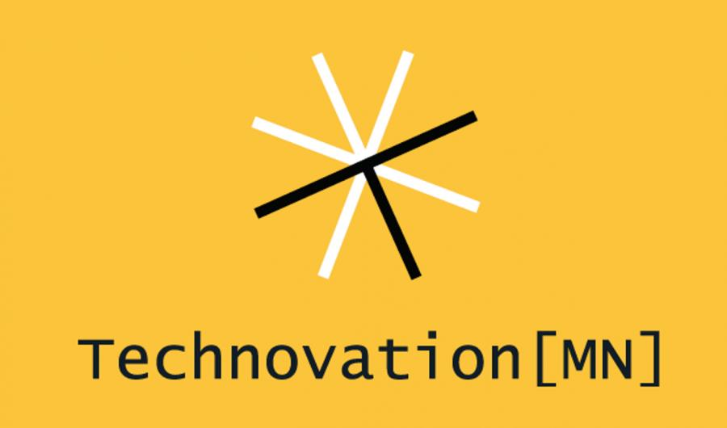
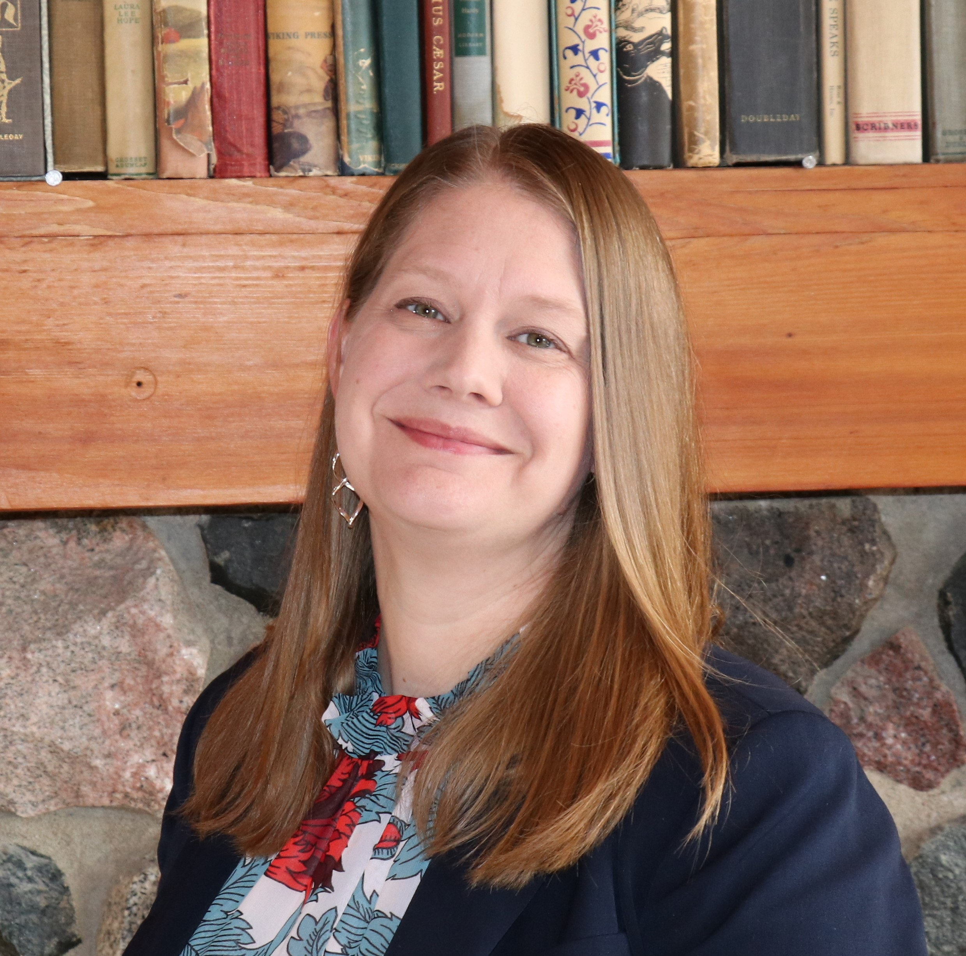
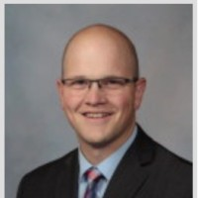
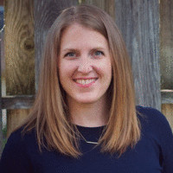
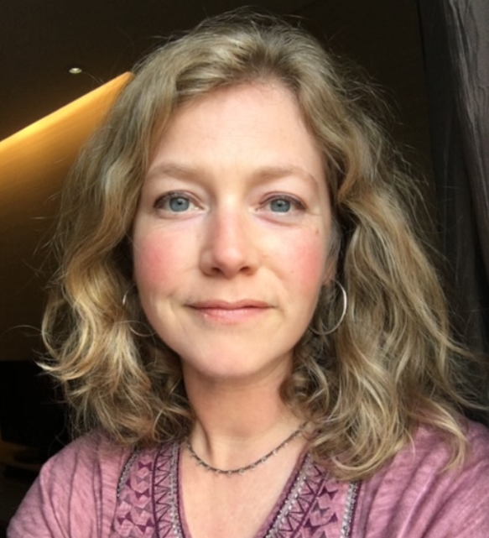
Building a STEM Directory for Young Women
Kati Longsdorf
Michael Klotz
Natalie Wires
Dan Chamberlain
Andrea Geer

Slide 2
Overview
“Technovation[MN] inspires and empowers girls to leverage technology to make an impact on their communities. A non-profit that brings technology and entrepreneurial programs to girls to spark interest, build technical knowledge, and develop confidence, their programs are for young women ages 10-18.” (Technovation[MN], 2020, About Us)
Challenges
There are many organizations in Minnesota -- including Technovation[MN] -- that create STEM programs, but each one’s offerings are a little different. There is no overarching database girls can turn to to understand the breadth of opportunities and get connected into a wide-variety of programs. Navigating all the programs and mentor opportunities can be an overwhelming and cumbersome process for girls and their families.
Notes:
Required: Brief description of our organization and what their mission/challenge is
Assessment of challenge and landscape analysis

Slide 3
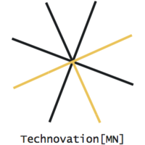
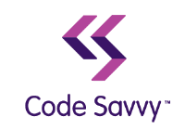
Lots of STEM-Focused Programs

Slide 4
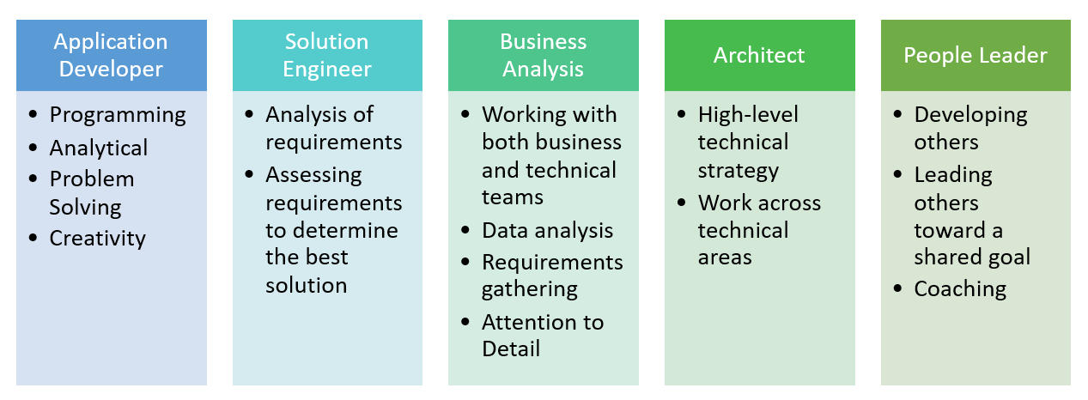
Building Different Skills

Slide 5
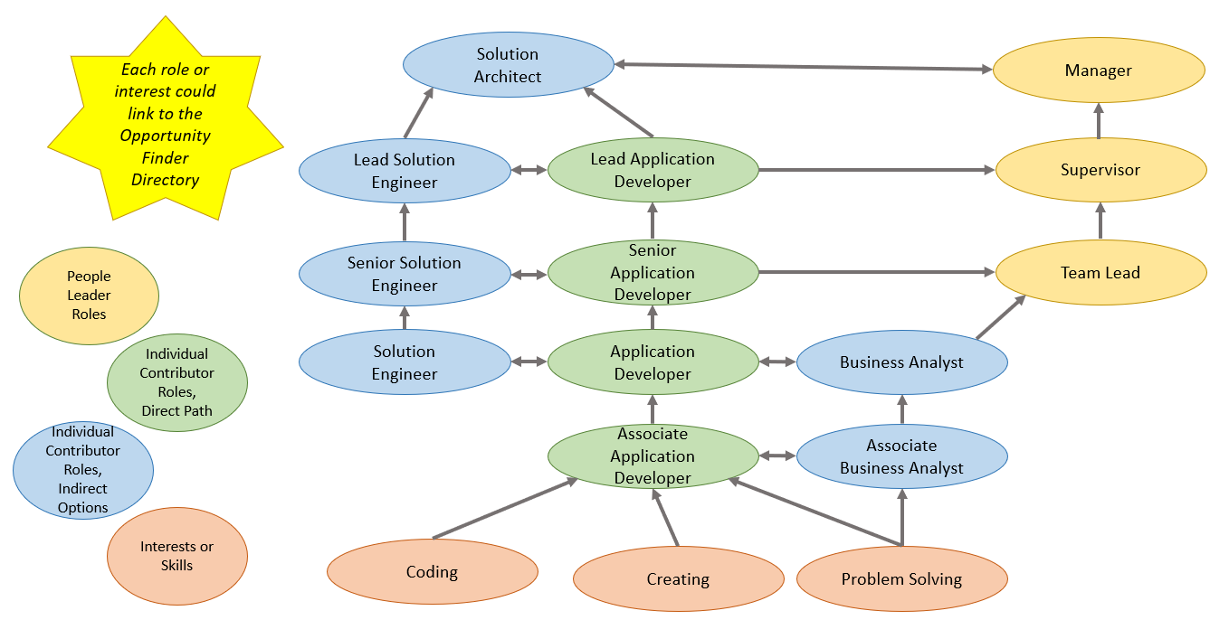
Linking Interests to Career Paths

Slide 6
Proposal: One place, unlimited STEM opportunities
Create an online directory that serves as a central hub of all STEM-focused youth programs in Minnesota. Girls and their families can search and learn about available programs and events, and connect with organizations working in this space. Organizations can create and update profiles detailing their programs to gain exposure and interest. Bridge the opportunities and programs together into more of a development framework.
Notes:
Is there some data visualization we can show that suggests that STEM is very important?

Slide 7
4 Phases of Development
Phase 1:
Directory
Phase 2:
Mentors
Phase 3:
Social Network
Phase 4:
Recruitment
Notes:
Could they have a competition to create the technovation directory? Then compile the best of the entries to make the final product?
How can we compile all of the contacts - initial data population of the directory….

Slide 8
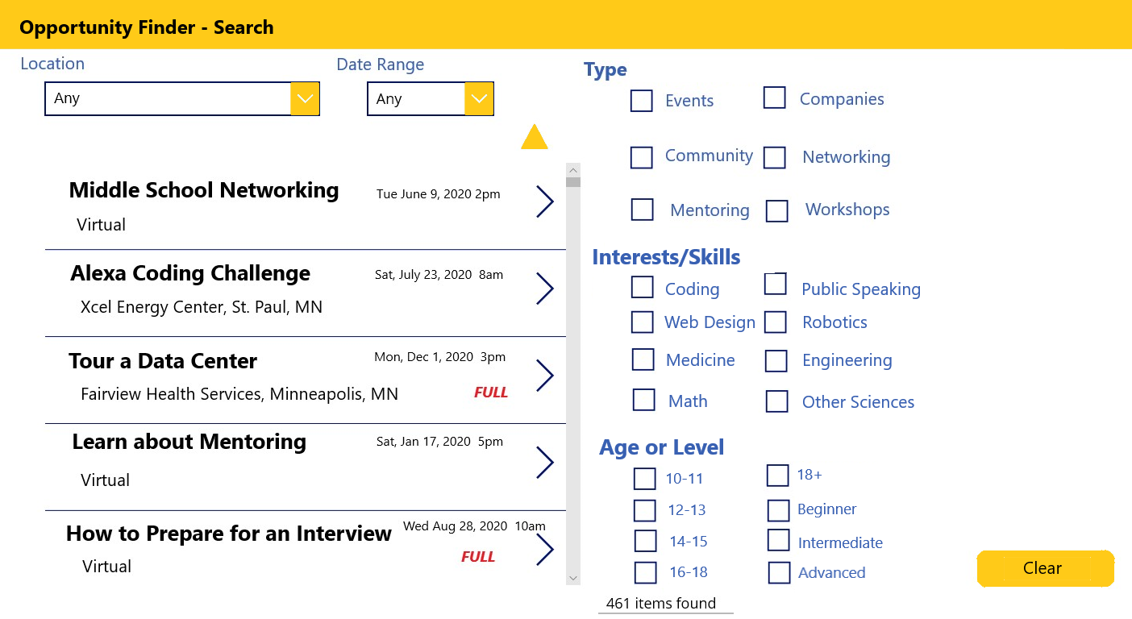
Phase 1: Directory
* Example shown as a basic online SharePoint list and Power App search front end.
Notes:
Elements of an Online MN STEM Resource Directory for girls:
Structure
Search function
By area in MN, category
Subscribe to email newsletter or for updates on certain categories
Add Listings
Non-profits, organizations, schools, companies
Membership to the network?
Events / calendar
Career center
Network guidelines
Tips / templates for listings and reviews
Policy for postings
Online behavior
Maintenance / Support
Website management services

Slide 9
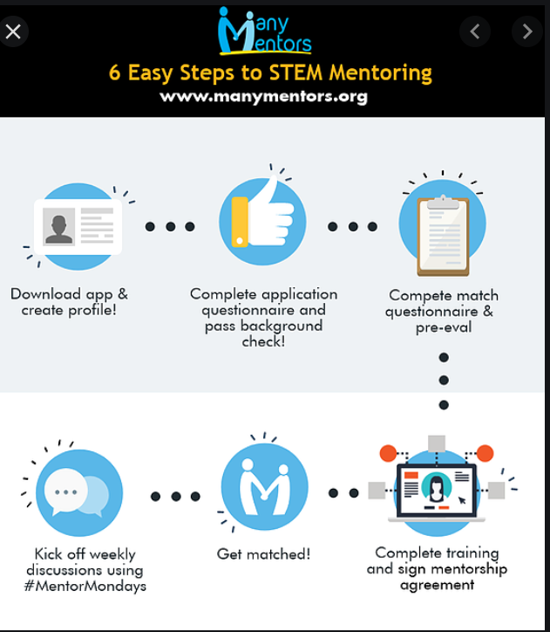
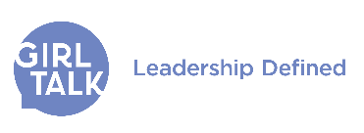
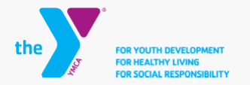
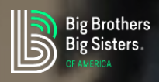
Phase 2: Mentors
Build the opportunity for potential mentors to apply for mentorships, learn about new opportunities, and partner with other organizations who match mentors with mentees.
Figure 1: Retrieved from https://www.manymentors.org/how-it-works
Notes:
One of the challenges for technovation is getting enough mentors. In this phase, we want to remove as many barriers to entry as possible for mentorship. We want to make it easy for mentors to apply and to find nearby mentees with similar interests and passions and we want to actively engage existing business partners to seek out more mentors.

Slide 10
Phase 3: Student Social Network
Students create a profile to showcase their STEM achievements and interests.
Badges for programs they’ve completed
Portfolio of projects
Connect with other girls with similar interests
Connect with potential mentors
Ability to transfer to LinkedIn, Instagram, Slack, Discord or other social networks to share updates
“Go where the students are”
Notes:
As a part of phase 3, we are looking to add the ability for students to create a personal profile that represents their interests and shows the projects they have completed.
Obviously, we are not trying to re-create Facebook and all of its features here, but we do feel it's important to implement something that will aggregate the student’s accomplishments and allow them to share their accomplishments with others.
Ultimately, we want to bring the students achievements together into the directory and allow them to share their accomplishments through integrations with other social networking sites. There is a lot to gain by allowing the students to share their accomplishments… It will increase awareness of the available STEM programs and act as a sort-of advertisement for the student’s social media followers.
The students profile and social networking will also help to connect mentors with similar interests.
“Go where the students are…”
Slack and Discord

Slide 11
Phase 4: Company Recruitment
Companies and organizations can create profiles to share their STEM-focused programs and find participants/talent, and kids can learn more about companies hiring tech talent.
Contact HR recruiting contacts (can usually be found on their job openings site or LinkedIn profile)
Present specific options for involvement, at different commitment levels
Mentoring Opportunities
Paid or Unpaid Internships
Short-Term Job Shadowing or Informational Interviews
One-time Field Trips or Site Visits
Host or Sponsor a Single Event
Volunteer opportunities
Notes:
Badges for programs they complete
Profile to showcase stem achievements

Slide 12
Additional Considerations
Marketing
Engaging business partners for mentors and sponsorship
Engaging schools for on-going student projects/workshops, after-school programs
Online Repository/Directory of Resources & Programs
Engaging community, crowd-sourcing resources and contacts
Companies and schools can create and update their own listing
Schools or Organizations could sponsor an event or workshop
Social Network for Students
Students could build a personal profile, add to it as they gain experience or interests; define and change their personal path
Connect with mentors, schools, and/or organizations
Connect with internships
Connect with companies for recruiting
Other Considerations
What will have costs to implement, what kinds of costs (up-front, on-going, etc)
Technology to use, how to build; What resources are available to maintain
Privacy considerations of children, parental consent and access
Measures of success to track during roll-out
Notes:
Should we break these out into dedicated slides?

Slide 13
Roadblocks & Challenges
Security
Collecting personal information
Choosing a strong hosting partner
Parent and Child legal implications
Sign up
Mentor Matching
Feedback loop
How do you measure success on each phase?
Notes:
Should we break these out into dedicated slides?

Slide 14
MNTech Board - How can you help?
How could your organization partner with Technovation[MN]?
Commit to building a profile for your company in the new directory
Offer volunteer resources for assisting with Technical Consulting or Solutioning
What other STEM programs for girls are you already partnering with?
Commit to partnering with Technovation[MN] on a student opportunity:
Host or Sponsor a Single Event
Encourage staff to volunteer for mentoring opportunities
Offer Paid or Unpaid Internships
Offer Short-Term Job Shadowing or Informational Interviews
Scholarship opportunities
Host One-time Field Trips or Site Visits
Contact Lisa Schlosser or Jade Denson!

Slide 15
Questions / Feedback
?

Slide 16
References
Technovation[MN]. (2020). About Us. Retrieved September 9, 2020, from https://technovationmn.org/about-us/
Many Mentors. (2020). How It Works. Retrieved September 9, 2020, from https://www.manymentors.org/how-it-works
Notes:
If we have time, we could walk through how the pages would look?

