Slide 1
Mental health:
Opportunity for impact in the tech community
Notes:
JESSE: How many of you know someone who is experiencing a mental health issue? Let's see a show of hands? This could be anxiety, seasonal effective disorder, depression, etc.

Slide 2
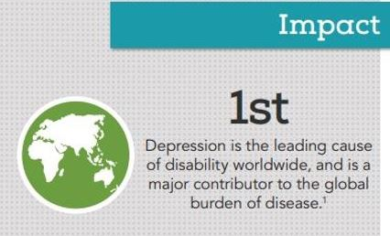
The Facts
One in five adults in America experience a mental illness
Source: National Alliance on Mental Illness
Notes:
JESSE: Well, we're not alone.....here is the mental health crisis in the numbers.

Slide 3
Treatment in America
Nearly 60% of adults with a mental illness didn’t receive mental health services in the previous year

Slide 4
mental health impacts the Tech community
10% of employees in the tech industry have a substance use disorder
$13,534 in extra costs are associated with a tech employee who has a substance use disorder
$8,466 in savings are obtained in the tech industry for each employee in recovery
Source: The National Center for Biotechnology Information
Notes:
There is a demonstrated need for solutions and treatment to mental health issues. STATS For our capstone project, we explored the following three questions.

Slide 5
The 2019 ACE Leadership Cohort Team
Shane Bratvold, Thomson Reuters
Jesse Kralewski, Mayo Clinic
Michelle Morgan-Nelsen, Entrust Datacard
Aparna Velamala, Mayo Clinic
Notes:
JESSE- for our project, we talked with leaders on mental health start-ups in the Twin Cities- and we belive that MHTA could play a greater role in helping this issue through technology. Let's briefly introduce our team.

Slide 6
Conversations with Startup founders
Sameer Kumar, founder
Grady Hannah, CEO
Melissa Kjolsing, co-founder
Notes:
Michelle:

Slide 7
opportunity
Digital health technologies are disrupting mental health and addiction treatments and improving outcomes
Our local workforce is impacted by mental health and addiction
MHTA has access to both regional technology talent and disruptive mental health start-ups
MHTA ​can support the intersection of technology and mental health
Notes:
MICHELLE A clear intersection with the MHTA mission and its advocacy work with the government, corporations, in STEM education and workforce development
Invest resources in this niche of the technology market can accelerate startups for measurable outcomes and expand innovation as part of the MHTA brand

Slide 8
action
Three ways to increase MHTA’s stewardship in mental health:
Raise awareness of mental health as a workforce issue
Activate member companies for pilots and early adoption of new technologies
Partner to create programming at the intersection of technology and mental health
Address mental health as a workforce issue
Notes:
JESSE:
1.
Tekne award category in 2020
Feature a mental health/addiction technology panel at the Spring Conference
2. from regional start-ups
3. with Medical Alley and start-up accelerators

Slide 9
MHTA Can Support the treatment of mental health in our Tech community
Notes:
JESSE: How many of you know someone who is experiencing a mental health issue? Let's see a show of hands? This could be anxiety, seasonal effective disorder, depression, etc.

Slide 10
Thank You
Shane Bratvold, shane.bratvold@thomsonreuters.com
Jesse Kralewski, Kralewski.Jesse@mayo.edu
Michelle Morgan-Nelsen, Michelle.Morgan-Nelsen@entrustdatacard.com
Aparna Velamala, Velamala.Aparna@mayo.edu

