Slide 1
the MINNESOTA high tech association ARE WE LIVING UP TO The name?
Notes:
Who do we want to be when we grow up?

Slide 2
IT FEELS LIKE THE TWIN CITIES it ASSOCIATION
NO
Notes:
Who do we want to be when we grow up?
Has Tech changed?

Slide 3
Strengthening Minnesota’s High-Tech Identity
Felix quast
Starkey Hearing Technologies
Charlie wild
WSB
Keith bennett
Comcast
Luke sipple
Self esteem brands
Stefan Kristensen
Hargrove & Associates

Slide 4
Our journey
Memberships
Poll results
MHTA’s Identity
Notes:
Each member of our team chose this project for their own, individual reasons, but collectively, we all had a common thought, how can we connect MHTA to greater Minnesota. At face-value, the questions nearly answer themselves. Find an affordable, technology-based solution and partners that can expand MHTA’s reach and membership ranks. As a group of IT problem solvers, we quickly dug-in and researched platforms and products that could do just that.
Finding a technical solution
Interviewed MHTA staff
What has been done by previous ACE cohorts?
Ambassador program
Transition year
What value does the MHTA offer its members
Why do companies join the MHTA

Slide 5
Memberships
Gubrud Consulting
Aeritae Consulting Group
Allianz Life
21 multi-year companies did not renew in 2019
Six of these were around for nine years
SWAT Solutions Inc.
Split Rock Partners
RBA Consulting
Notes:
Each member of our team chose this project for their own, individual reasons, but collectively, we all had a common thought, how can we connect MHTA to greater Minnesota. At face-value, the questions nearly answer themselves. Find an affordable, technology-based solution and partners that can expand MHTA’s reach and membership ranks. As a group of IT problem solvers, we quickly dug-in and researched platforms and products that could do just that.

Slide 6
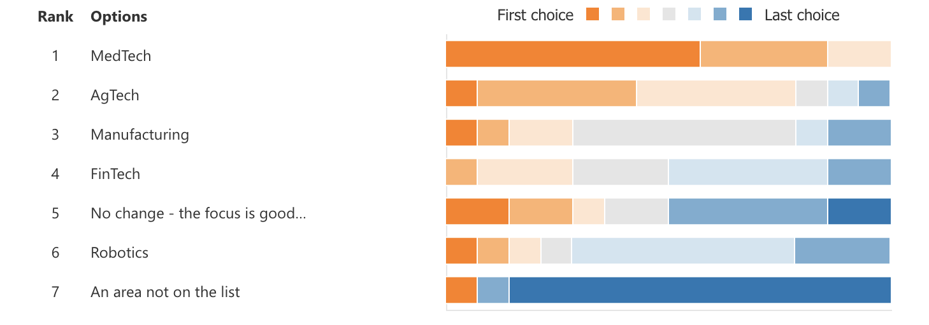
MHTA Technology Focus too Narrow
Notes:
New members need a different focus from MHTA to provide value
This sample poll illustrates MHTA technology focus is too narrow and more research is necessary
One half of our ACE leadership members knew about MHTA before this class

Slide 7
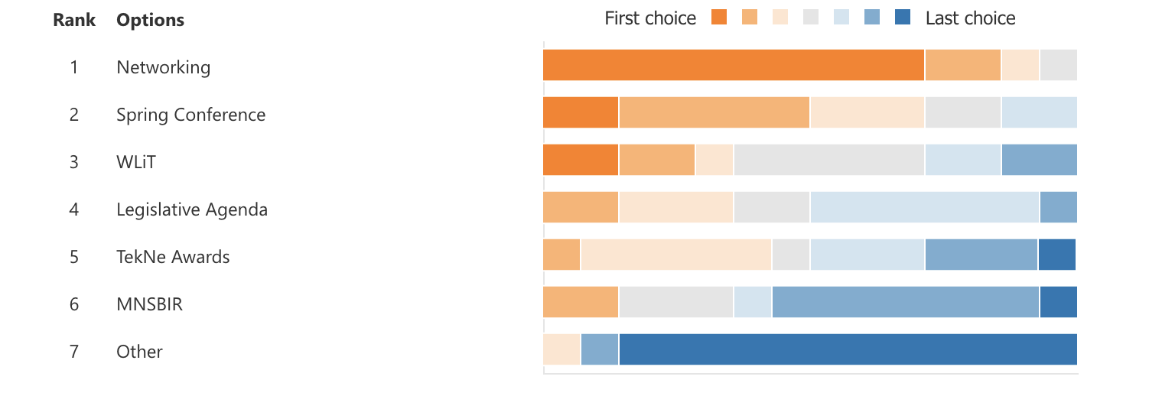
ACE Membership Value
Notes:
Networking should not outclass all other VALUES
Online platform comes into play here

Slide 8
MHTA continued relevance is low post ACE Program
Not Relevant
Notes:
5.79% on a scale from 1 to 10 thought the MHTA would not be relevant after the end of the program.

Slide 9
Identity: live up to the name - MHTA
The MTHA should do the following:
Embrace a broader definition of technology
AgTech, FinTech ?
Clarify the MHTA’s identity and sub-organizations
Emphasize that SciTechsperience and SBIR are part of the MHTA
Consistency across websites
Notes:
Revisit Grabber:
This is the core problem.
Are we living up to the name? This is the foundation of how we get to a ”yes”.

Slide 10
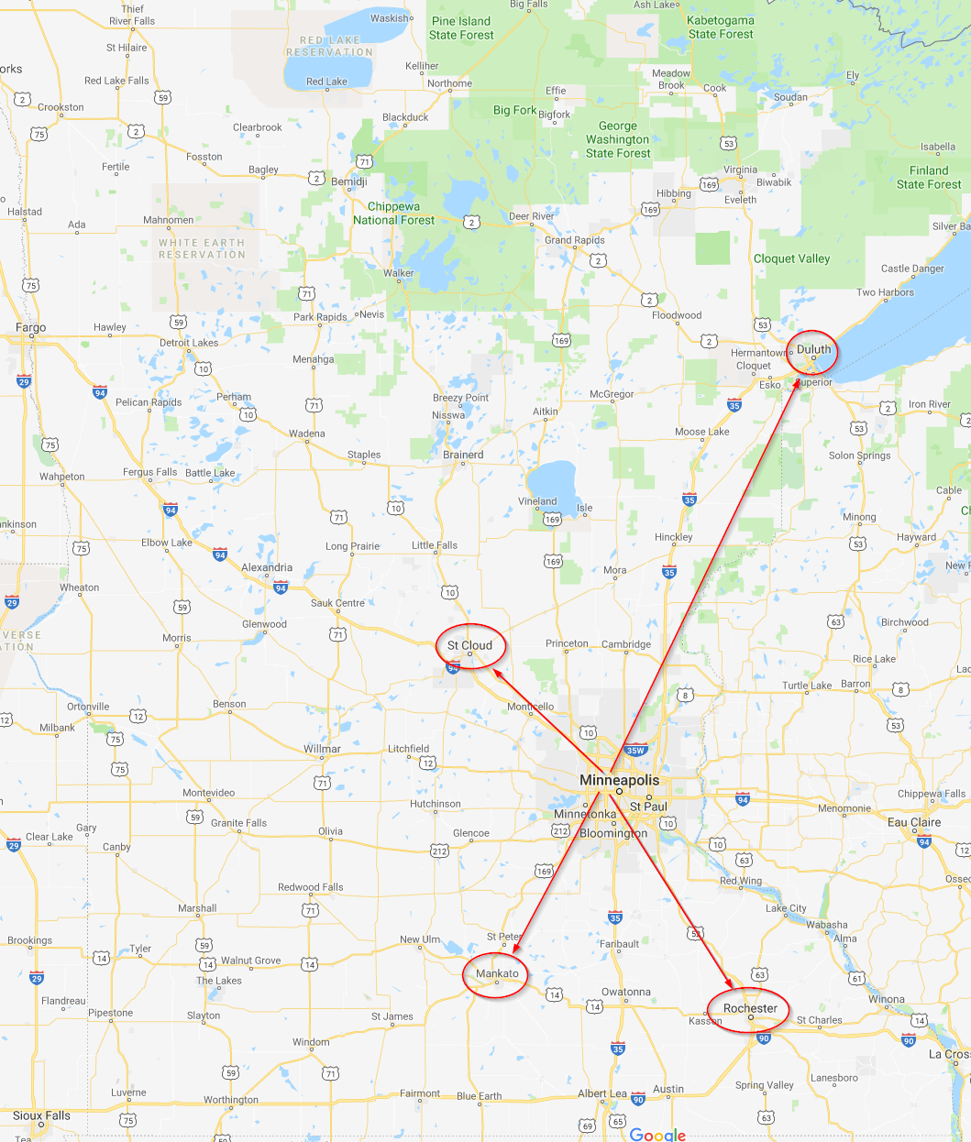
build community and expansion
Reinvigorate the Ambassador Program
Build an online community and platform that serves all sub-organizations of the MHTA
Notes:
Partner where it’s practical lead where necessary

Slide 11
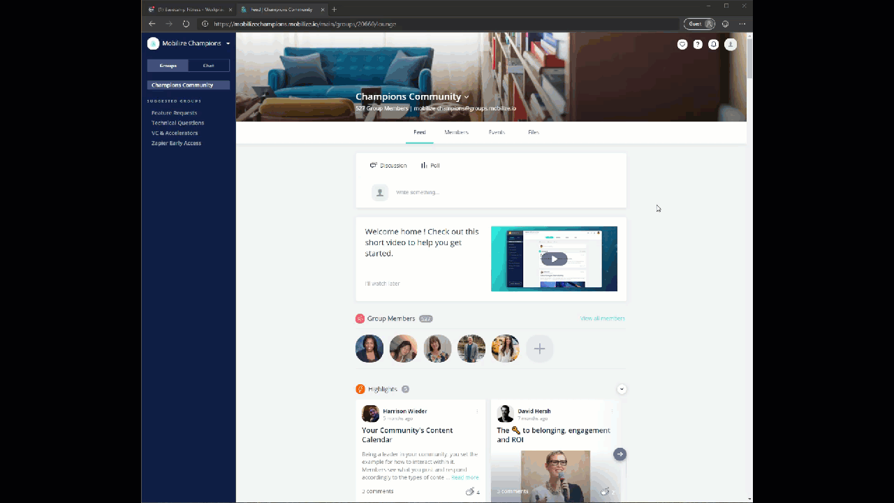
Notes:
This can be all MHTA branded.
The groups on the left would be, for example; The ACE program, SBIR, SciTechsperience, AgTech, etc.

Slide 12
This is a time to be bold, not a time to be Minnesota Nice.
NO
YES
Notes:
Once there is clarity and direction and expansion has begun, now you can call yourselves the Minnesota High Tech Association.

Slide 13
Now we can call ourselves the Minnesota high tech association
YES
Notes:
Who do we want to be when we grow up?
Has Tech changed?

Slide 14
What’s next? That is up to YOU!

